Slide 1

Notes:
# Welcome!

Slide 2
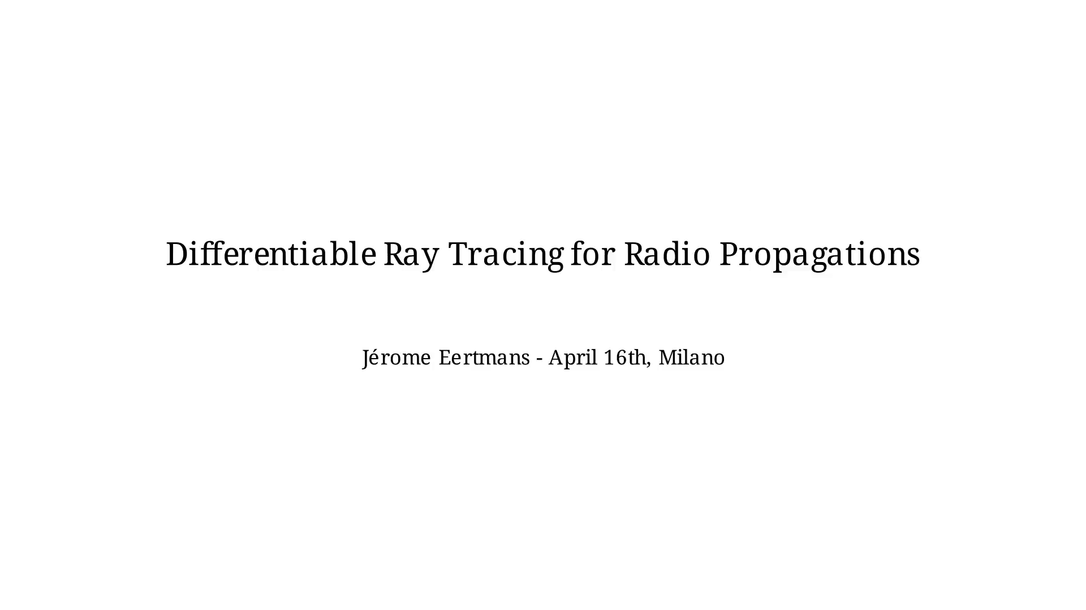
Notes:
Let's start by presenting myself quickly!

Slide 3


Slide 4
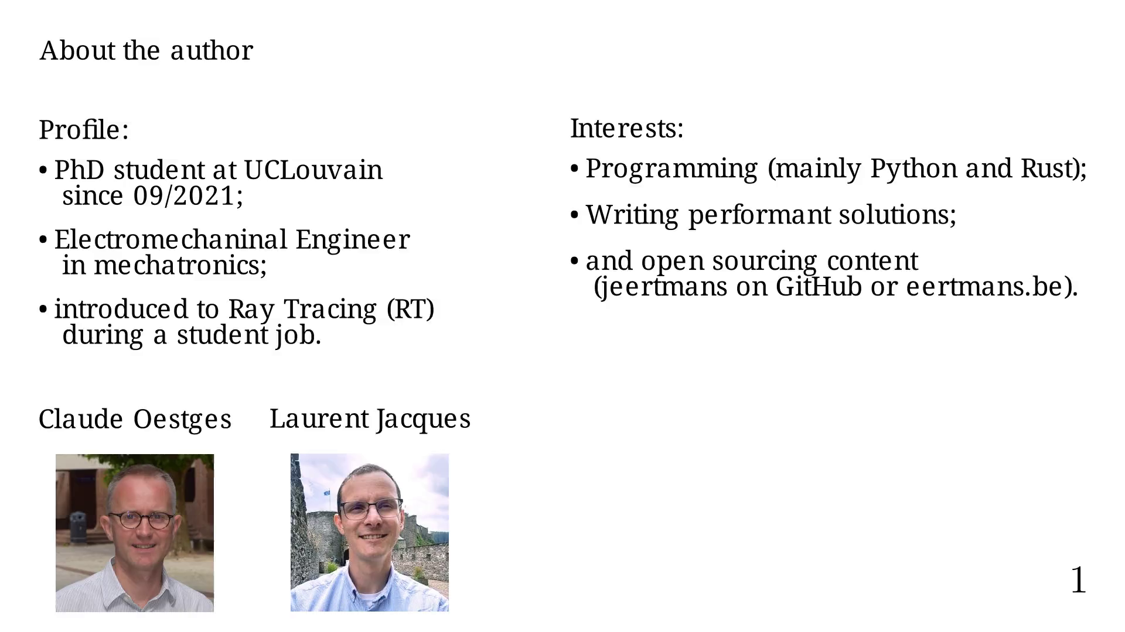
Notes:
Disclaimer

Slide 5
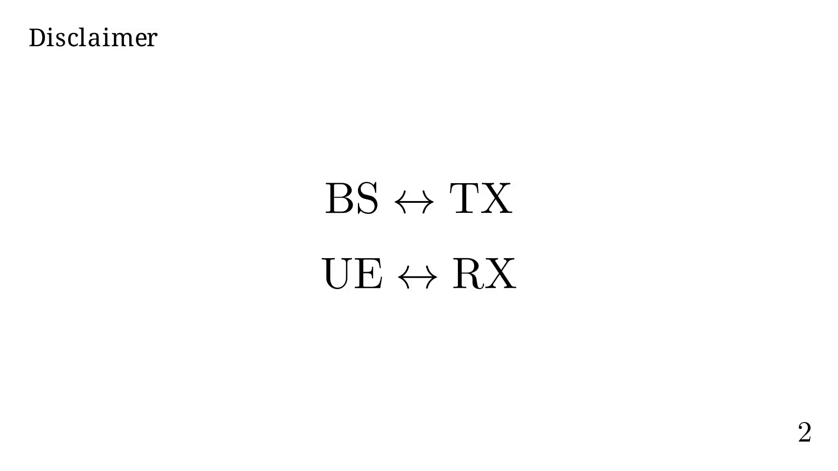
Notes:
Ray Tracing's ABC

Slide 6
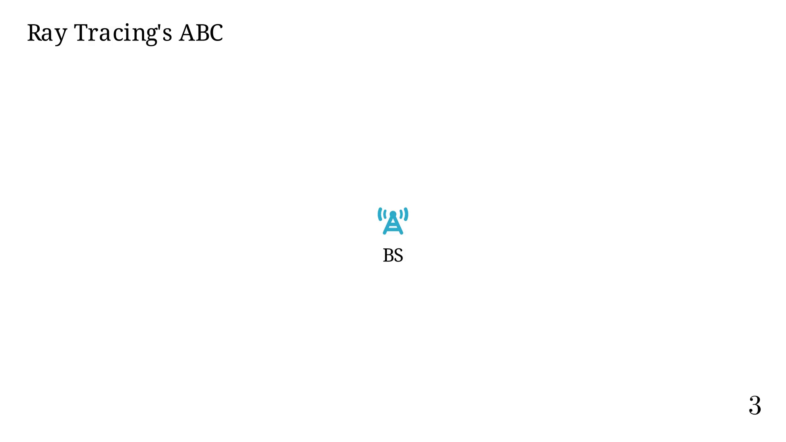
Notes:
In a simplified model, the BS emits waves isotropically.

Slide 7

Notes:
Using Huygen's principle, we can decompose a wave front into a
series of new wave sources.

Slide 8
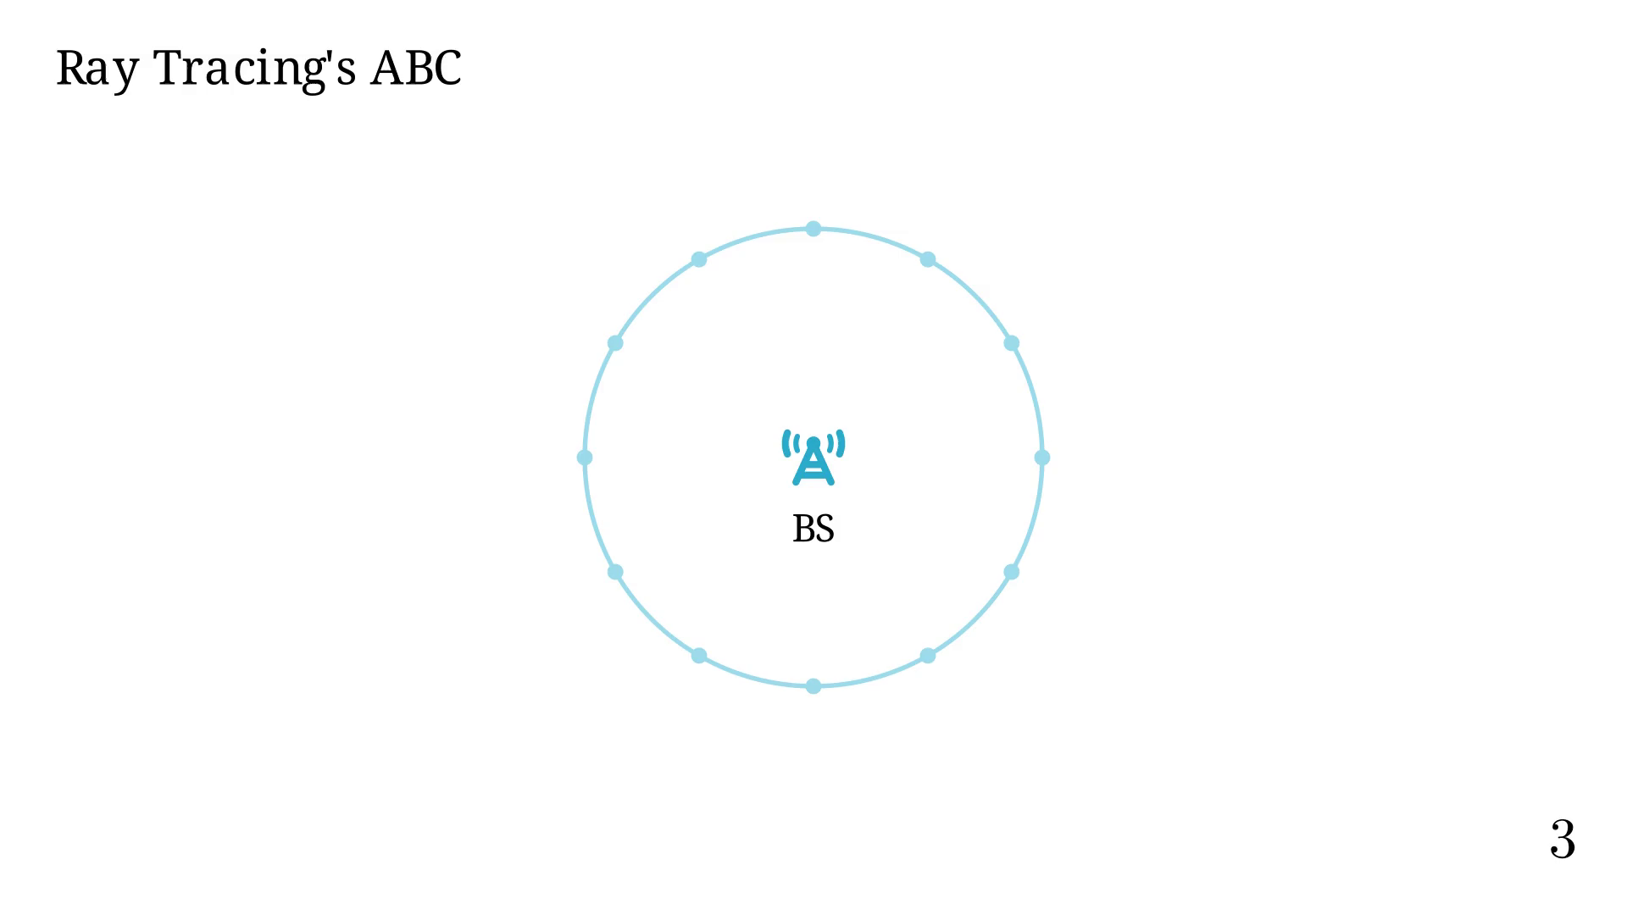
Notes:
Each source now broadcasts waves,
each with a fraction of the original energy

Slide 9


Slide 10
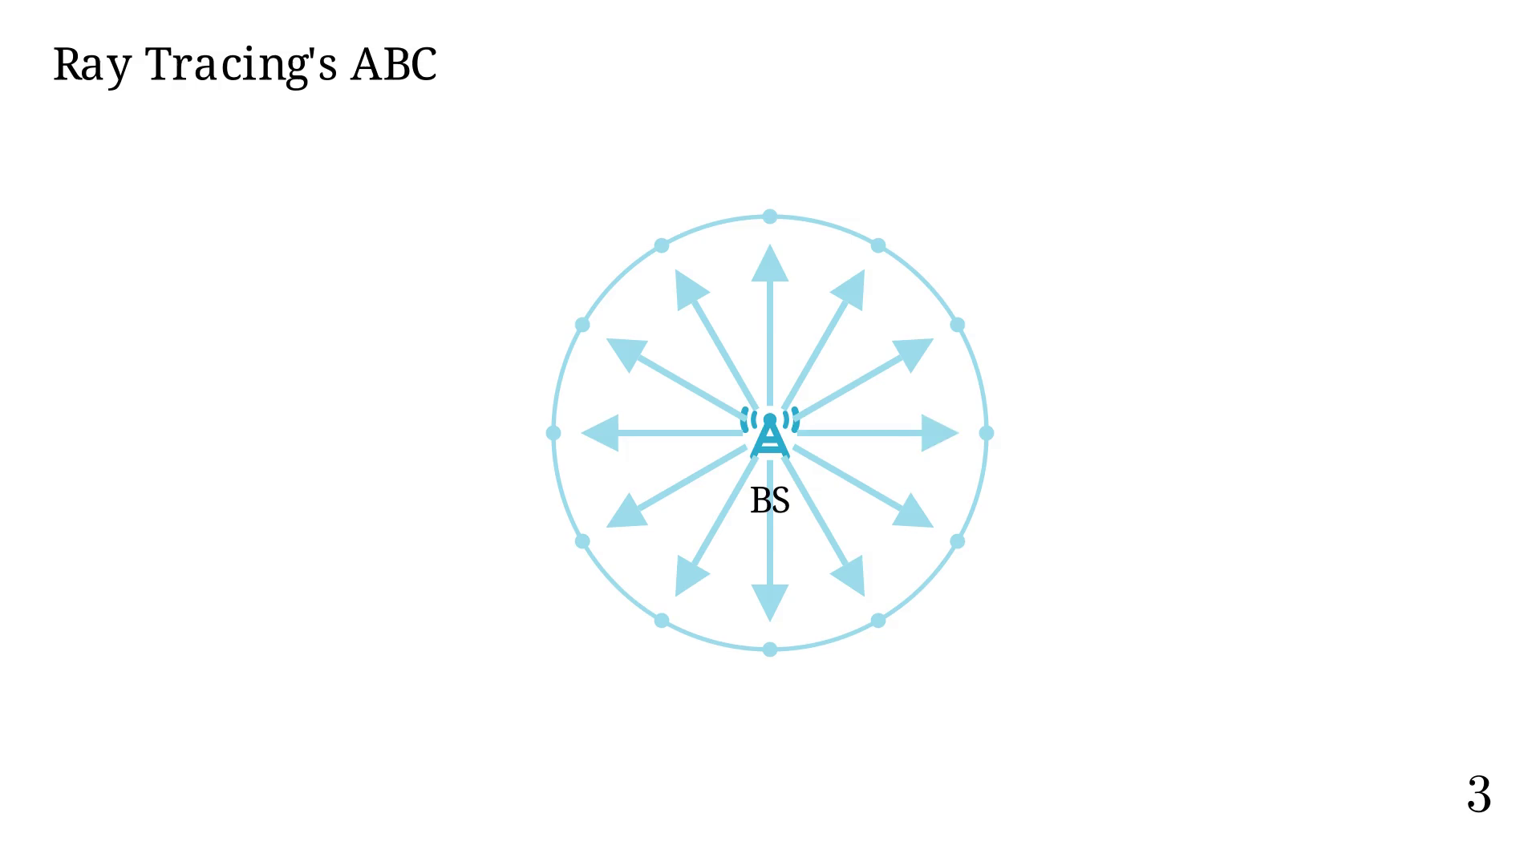
Notes:
RT considers each ray path individually.

Slide 11
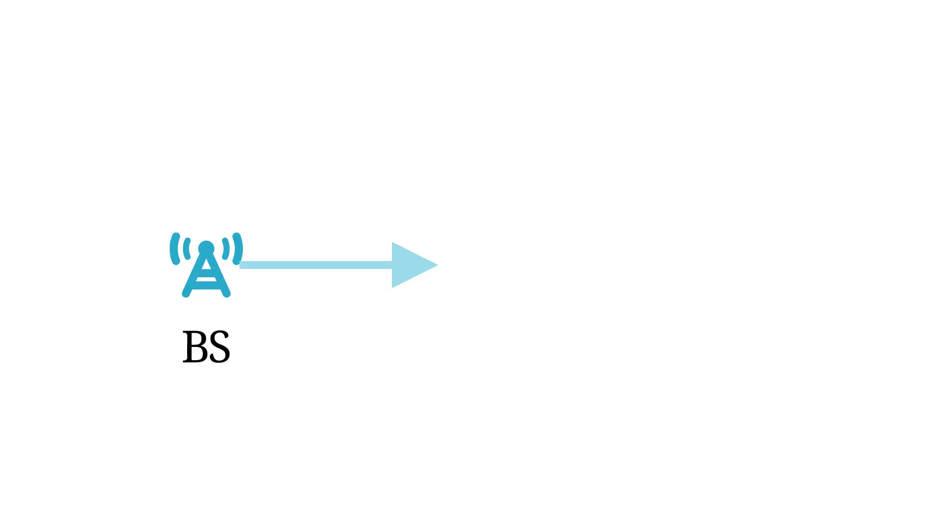
Notes:
In a constant speed space, ray paths are linear.

Slide 12
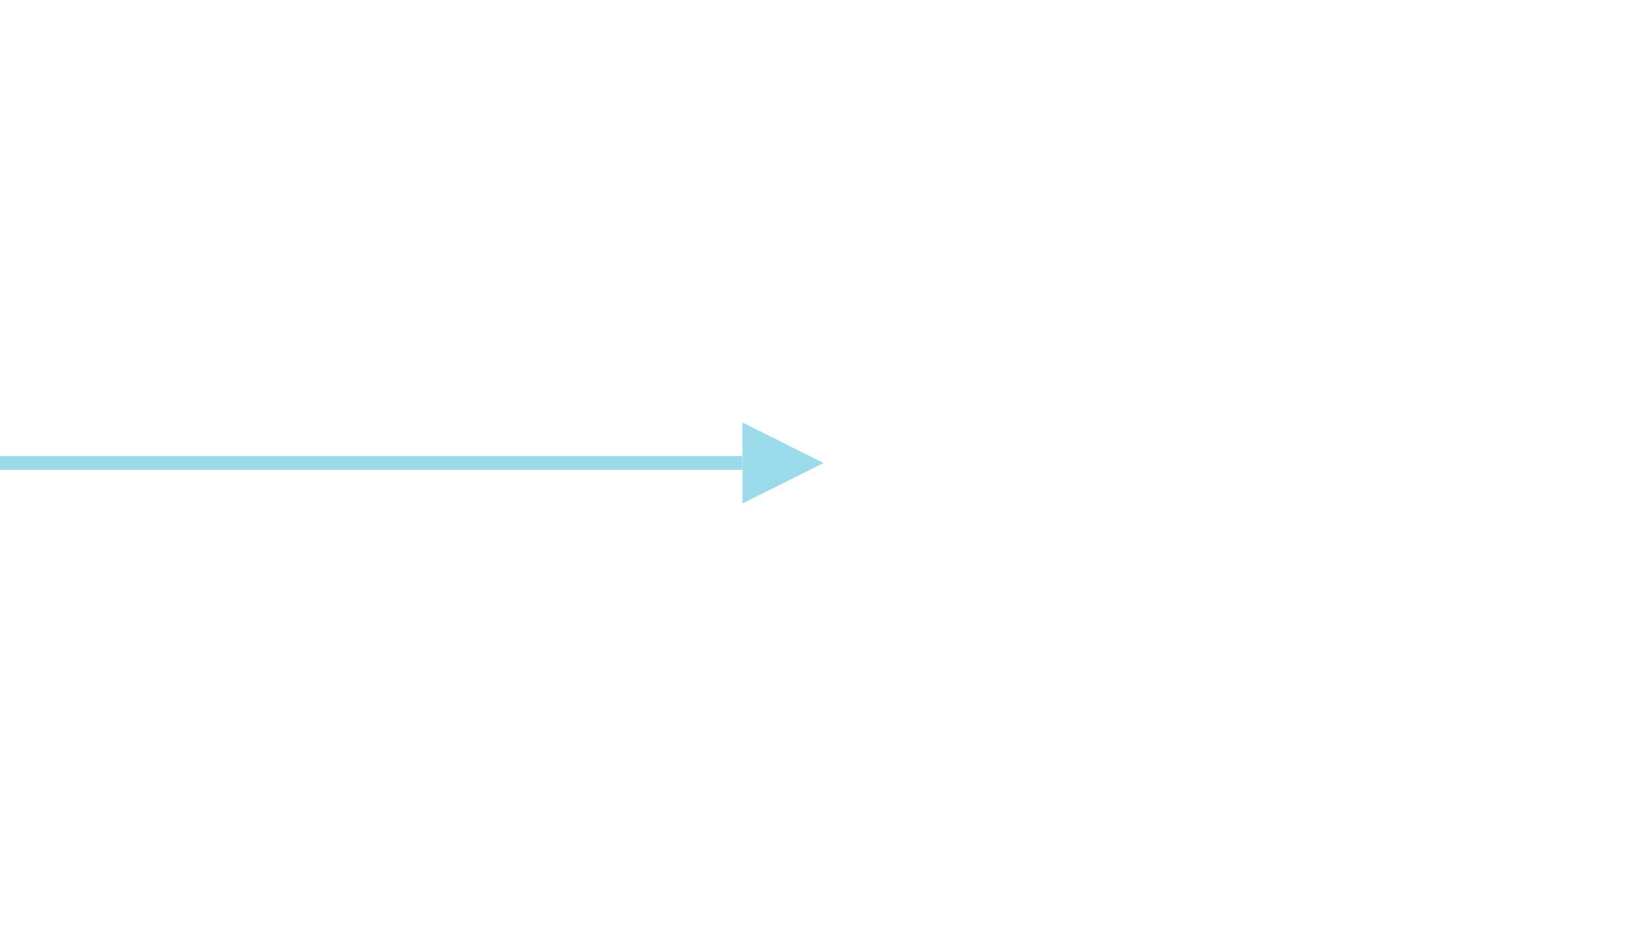
Notes:
Maybe, we reach some obstacle.

Slide 13
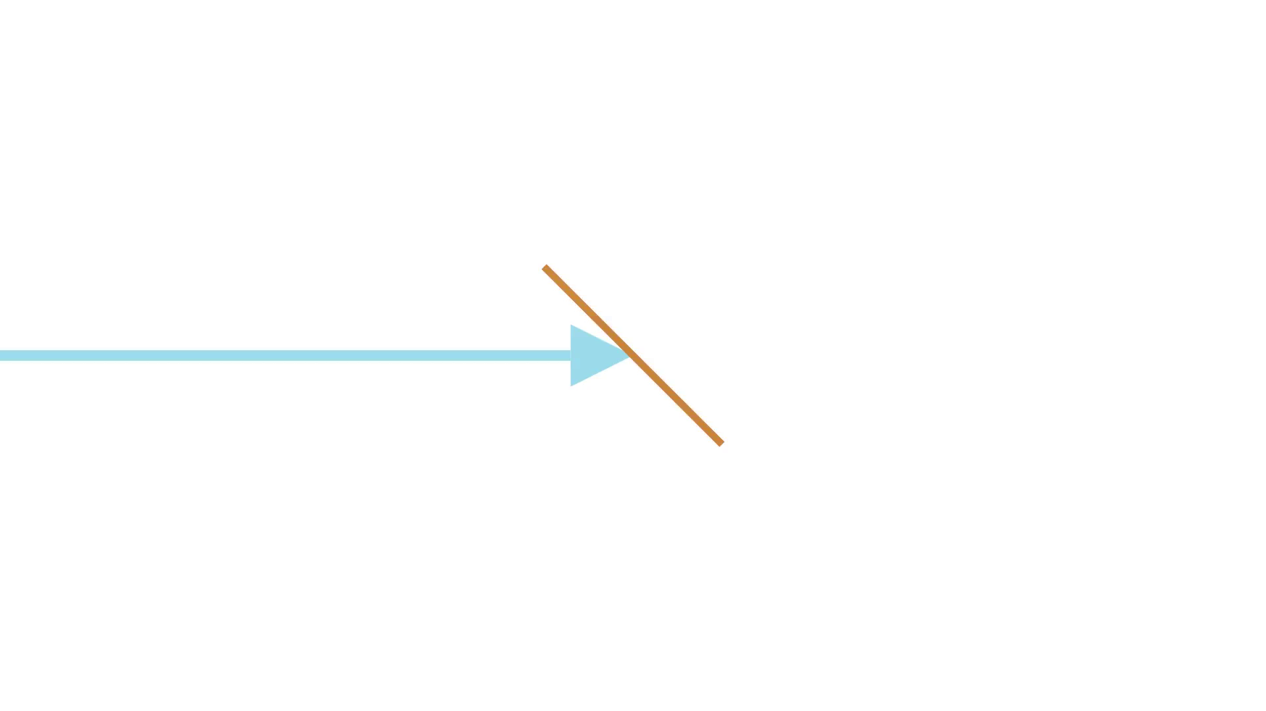
Notes:
If we decide to apply reflection.

Slide 14
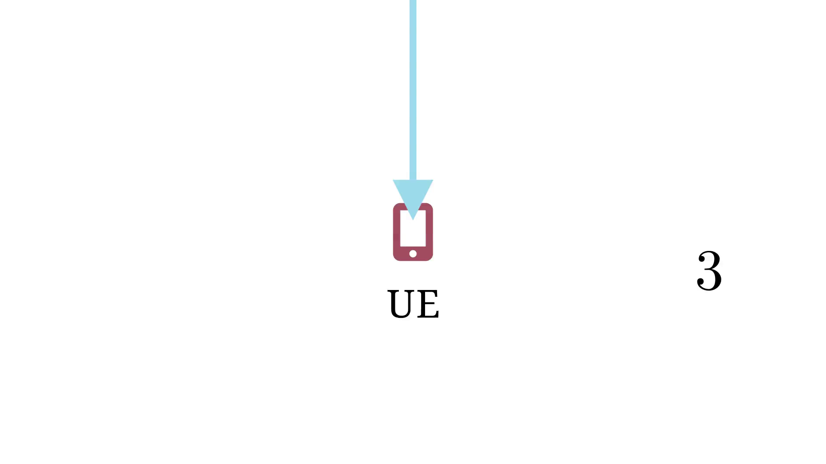
Notes:
We can do that for very complex scenes and many paths.

Slide 15
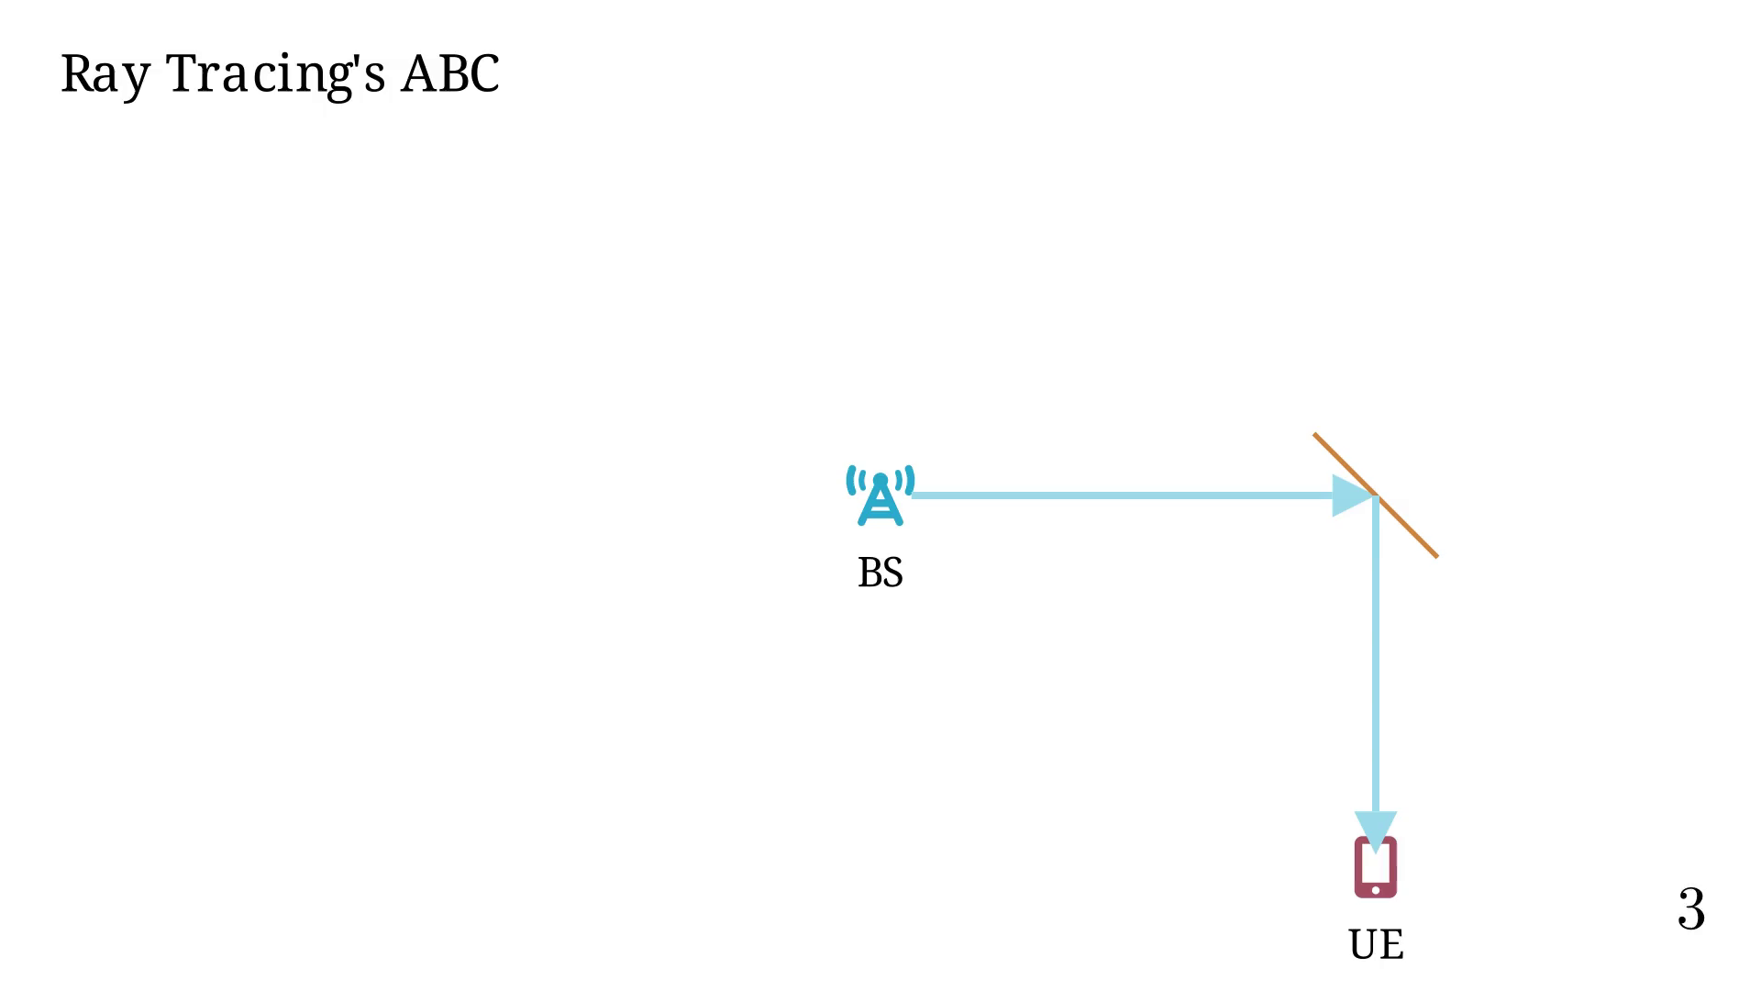
Notes:
Example of tracing paths in 3D Urban scene.

Slide 16
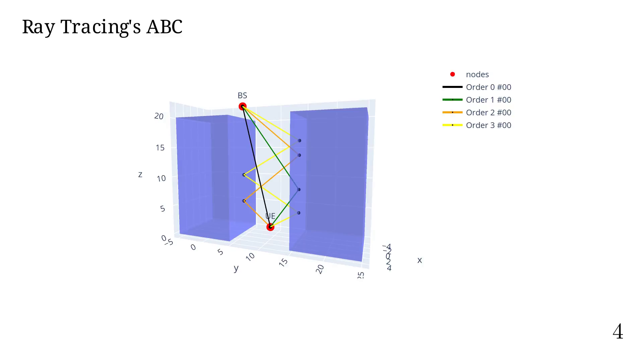
Notes:
In Radio-propa., we have two quantities: E and B.
Both are vectors (3D) and complex.
But, only 2 components are needed!! Hence 2x2 dyadic matrices.
The most used quantify if E, from which we usually determine
the received power (plane wave, lossless medium).

Slide 17
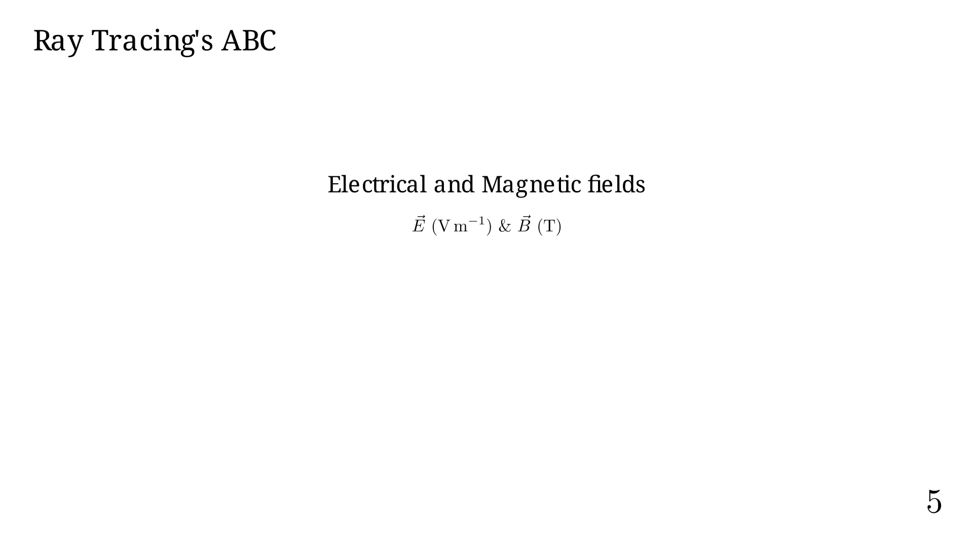
Notes:
By superposition, E (and B) can be computed by summing the contribution
from each path.

Slide 18
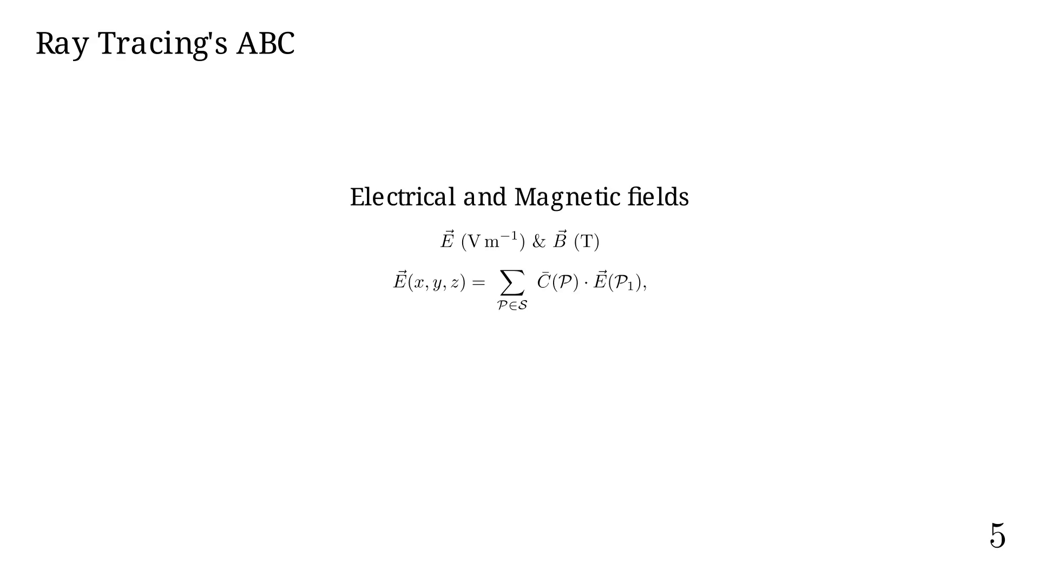
Notes:
Where C accounts for:
- D the dyadic coefficients for polarization;
- alpha the path attenuation;
- and the path delay.

Slide 19
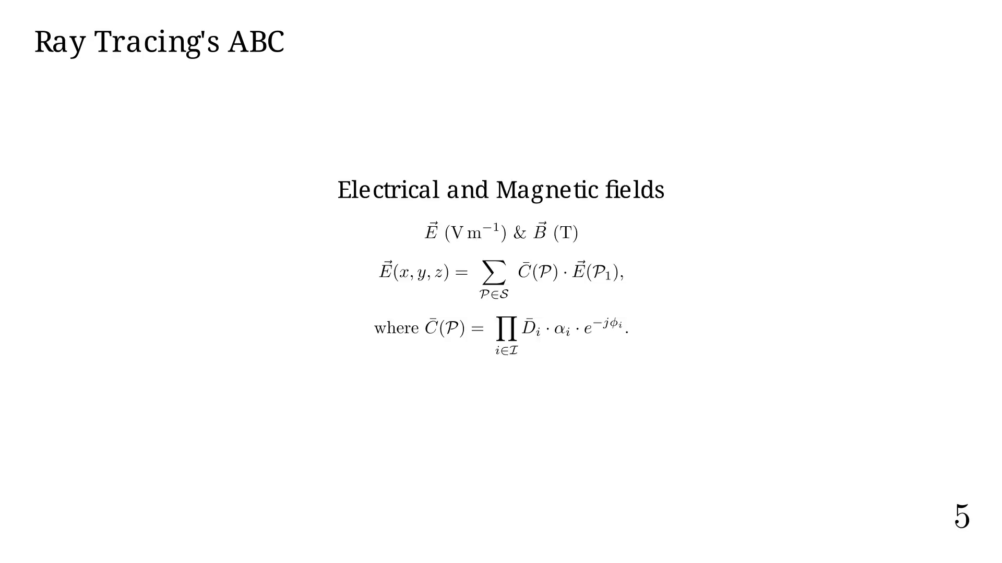
Notes:
The basic RT pipeline is as follows.

Slide 20
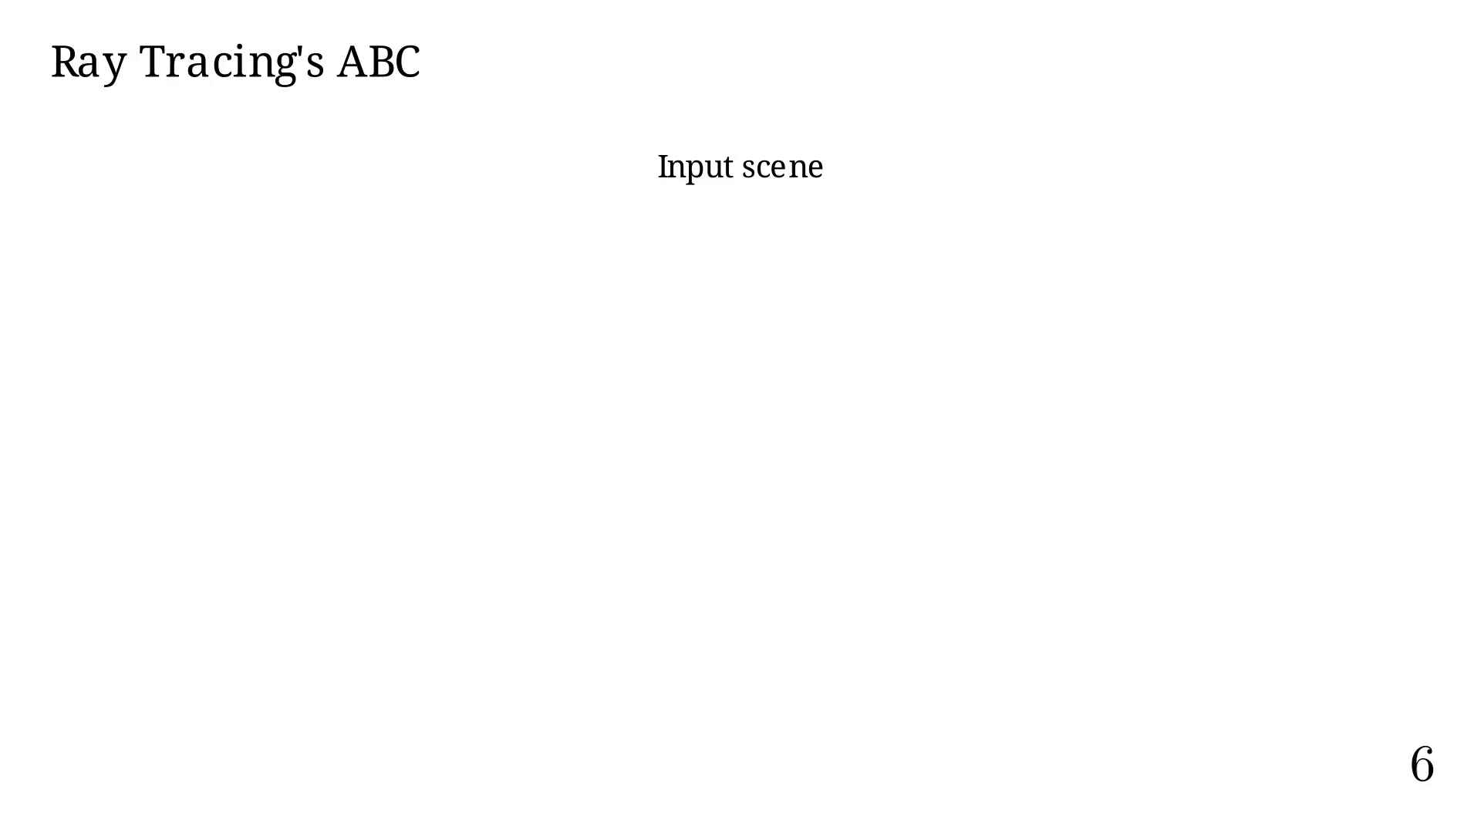
Notes:
Next pipeline step.

Slide 21
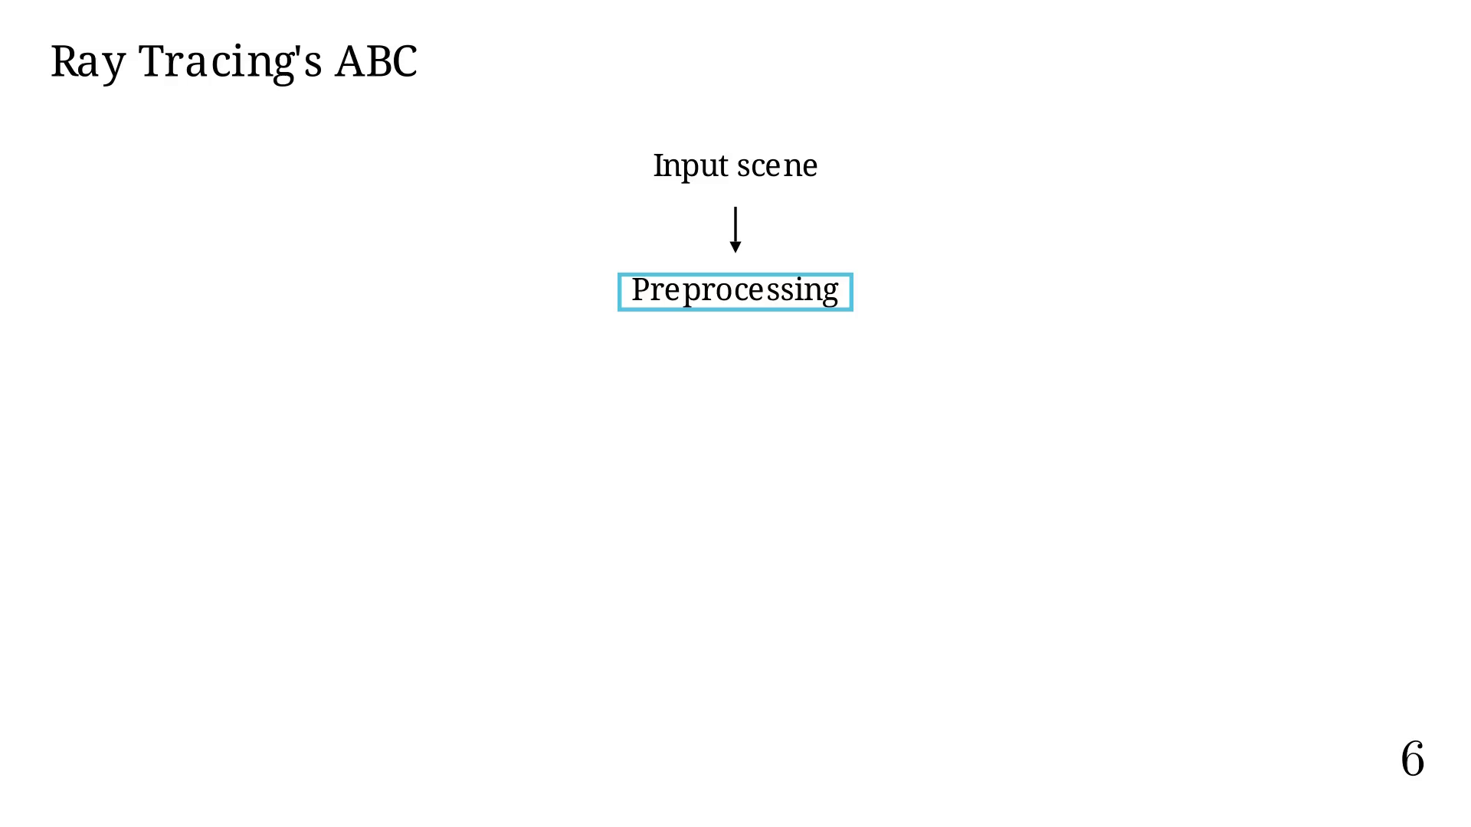
Notes:
Next pipeline step.

Slide 22
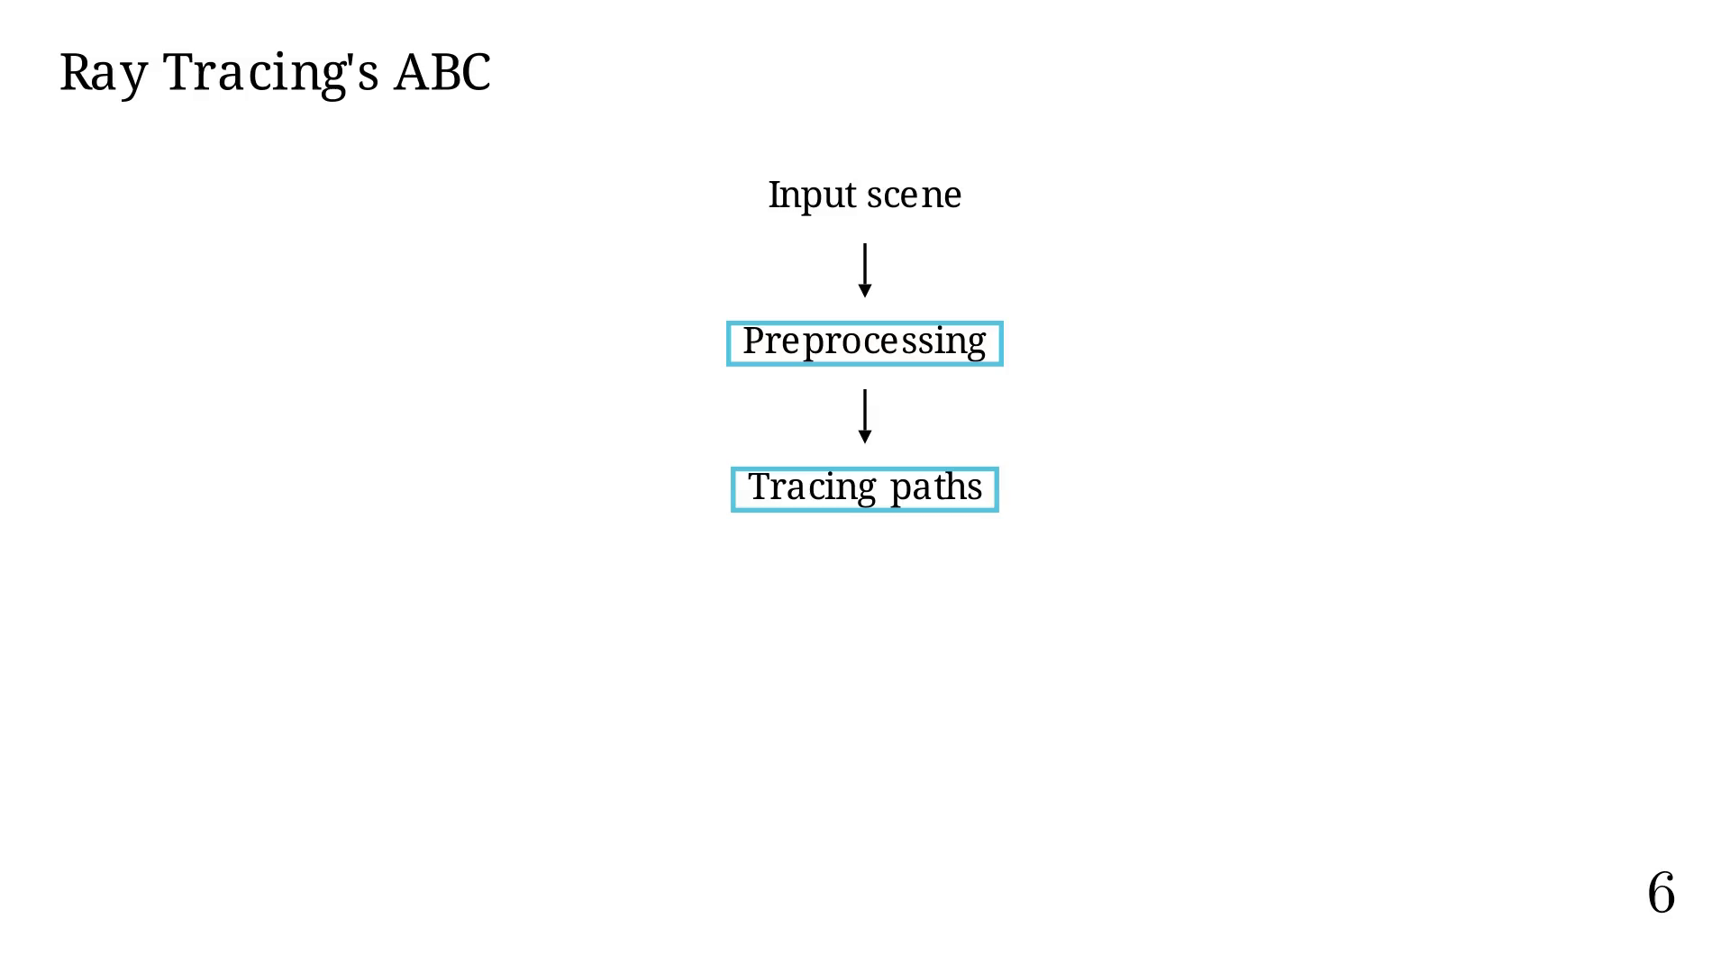
Notes:
Next pipeline step.

Slide 23
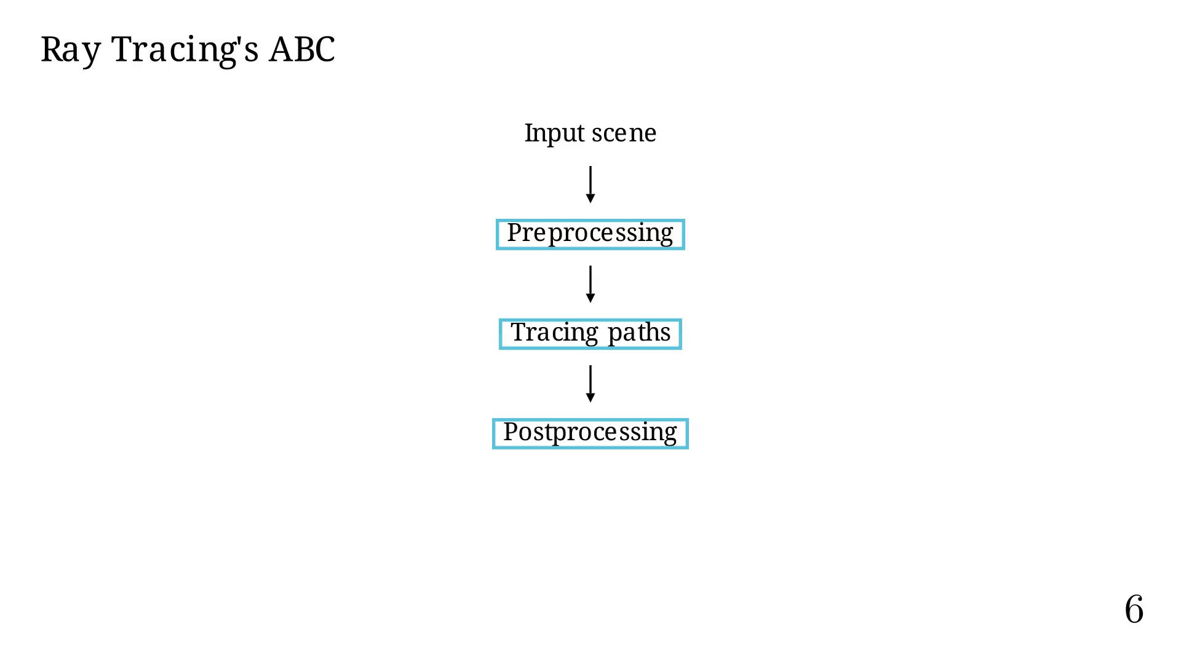
Notes:
Next pipeline step.

Slide 24
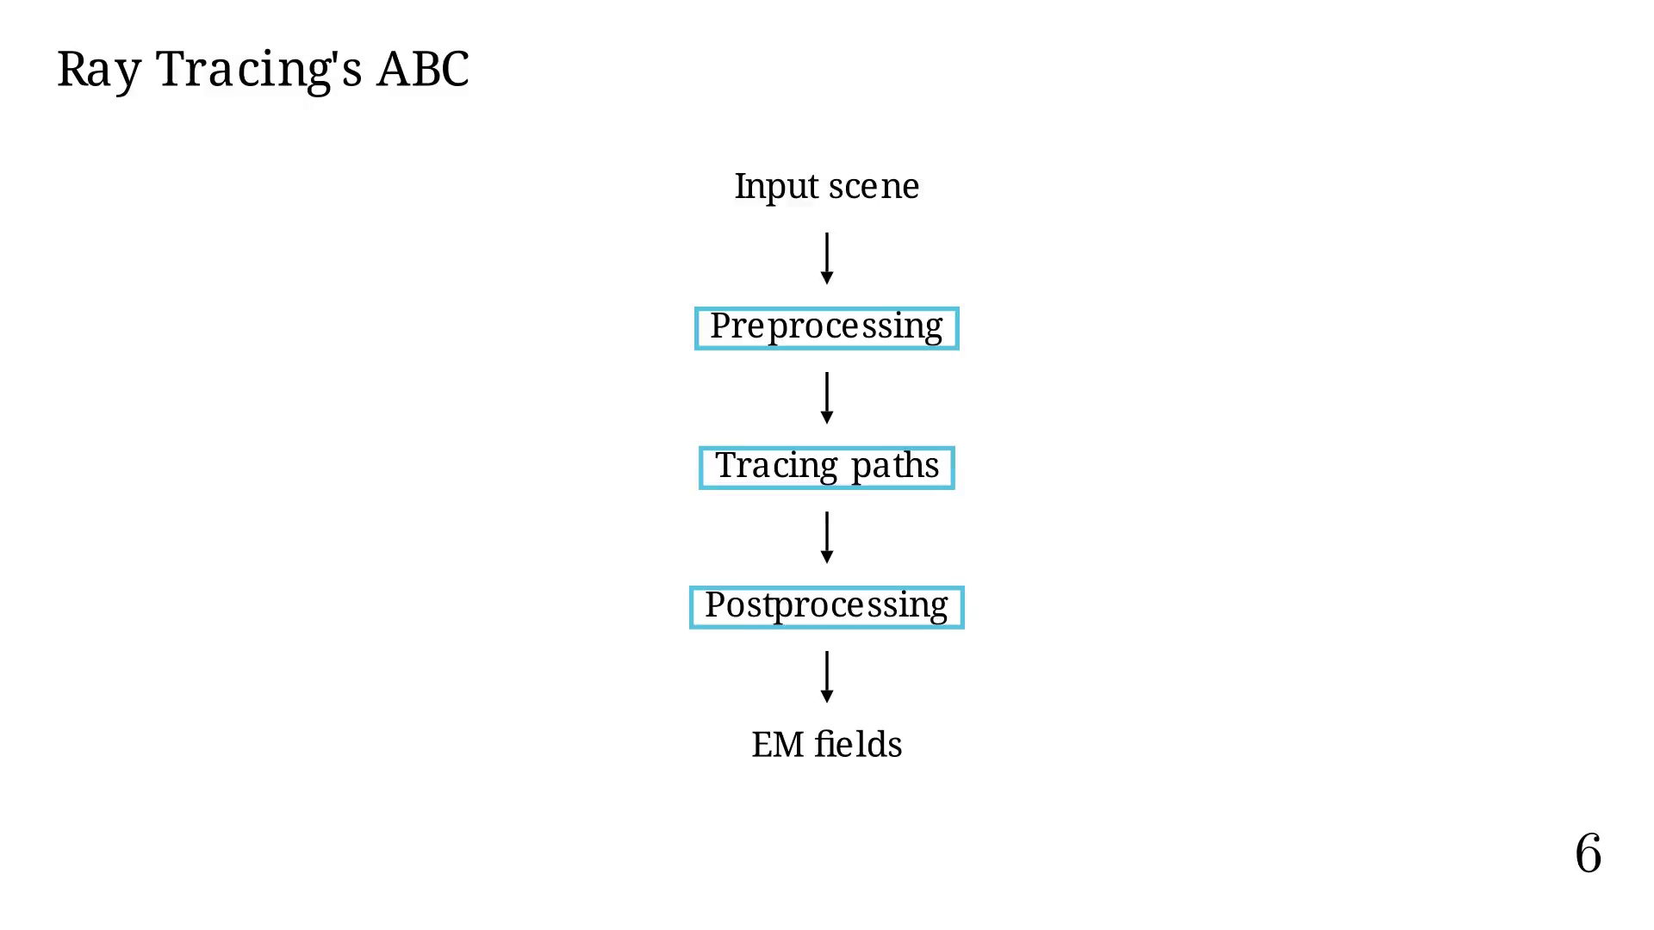
Notes:
# Tracing paths
We now use TX/RX.

Slide 25
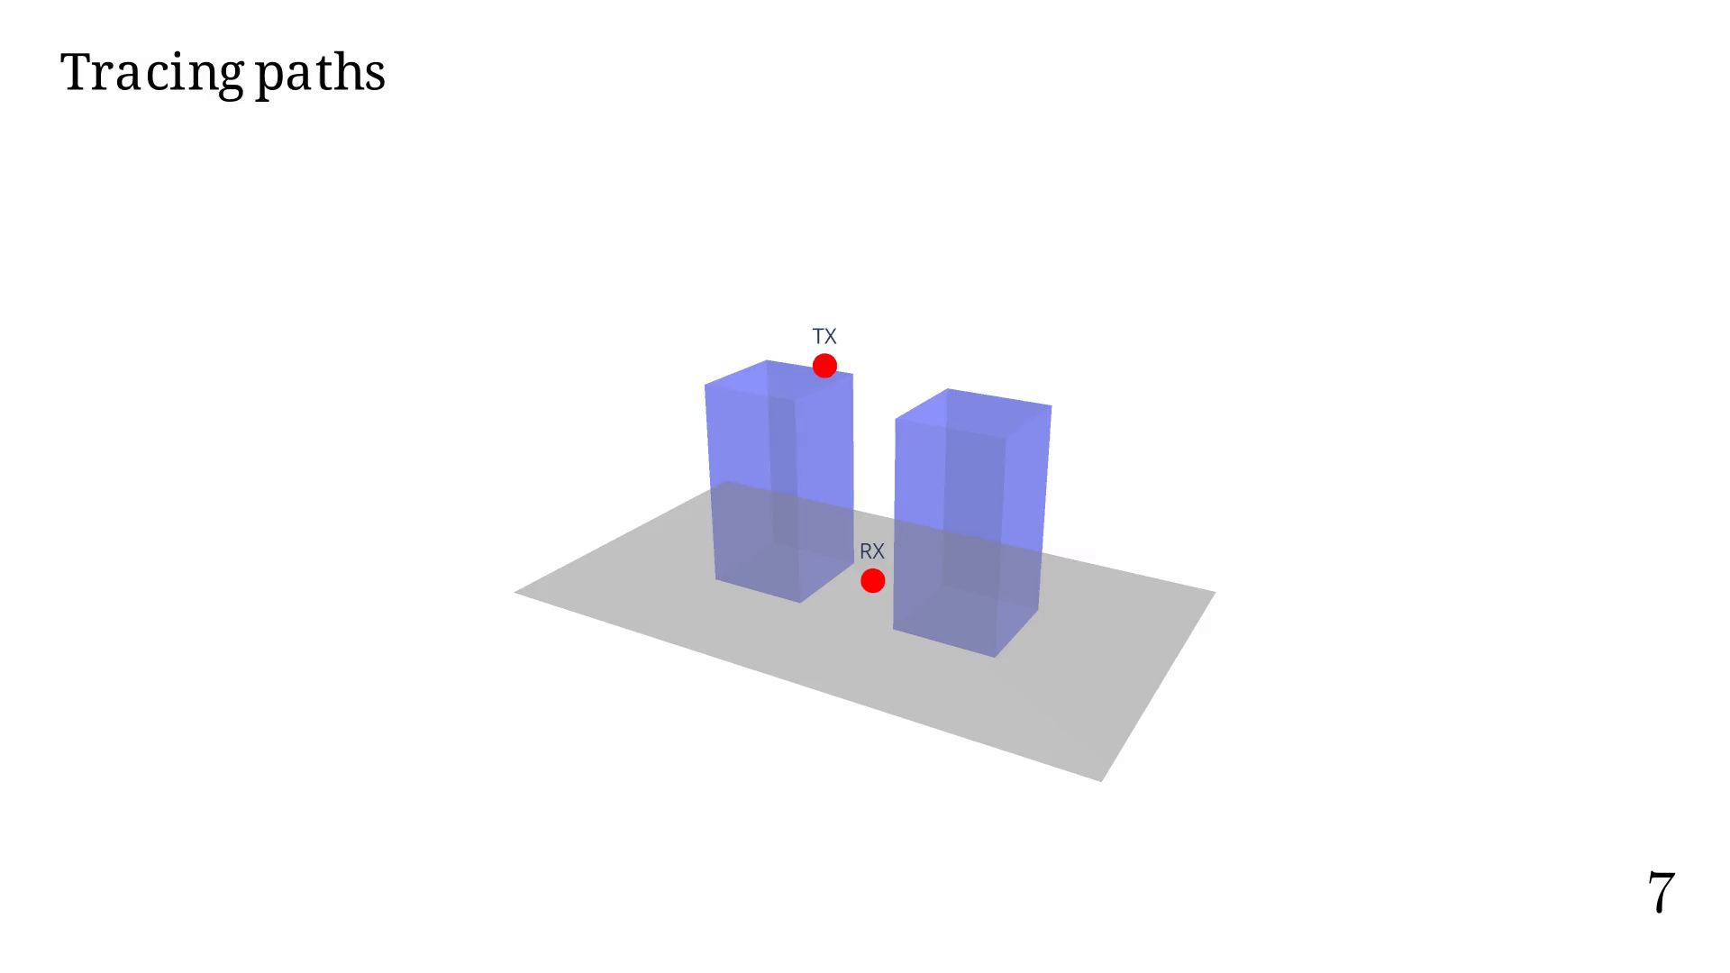
Notes:
Order = 0

Slide 26

Notes:
Order = 1

Slide 27

Notes:
Order = 2

Slide 28

Notes:
Order = 3

Slide 29

Notes:
Order = 4

Slide 30
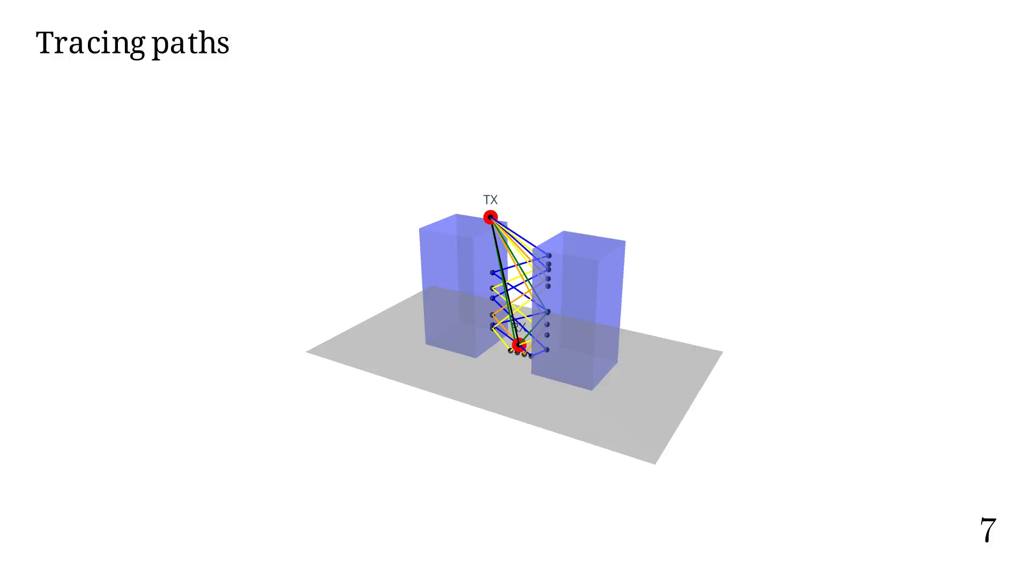
Notes:
# In a previous work we presented a method for tracing paths.

Slide 31
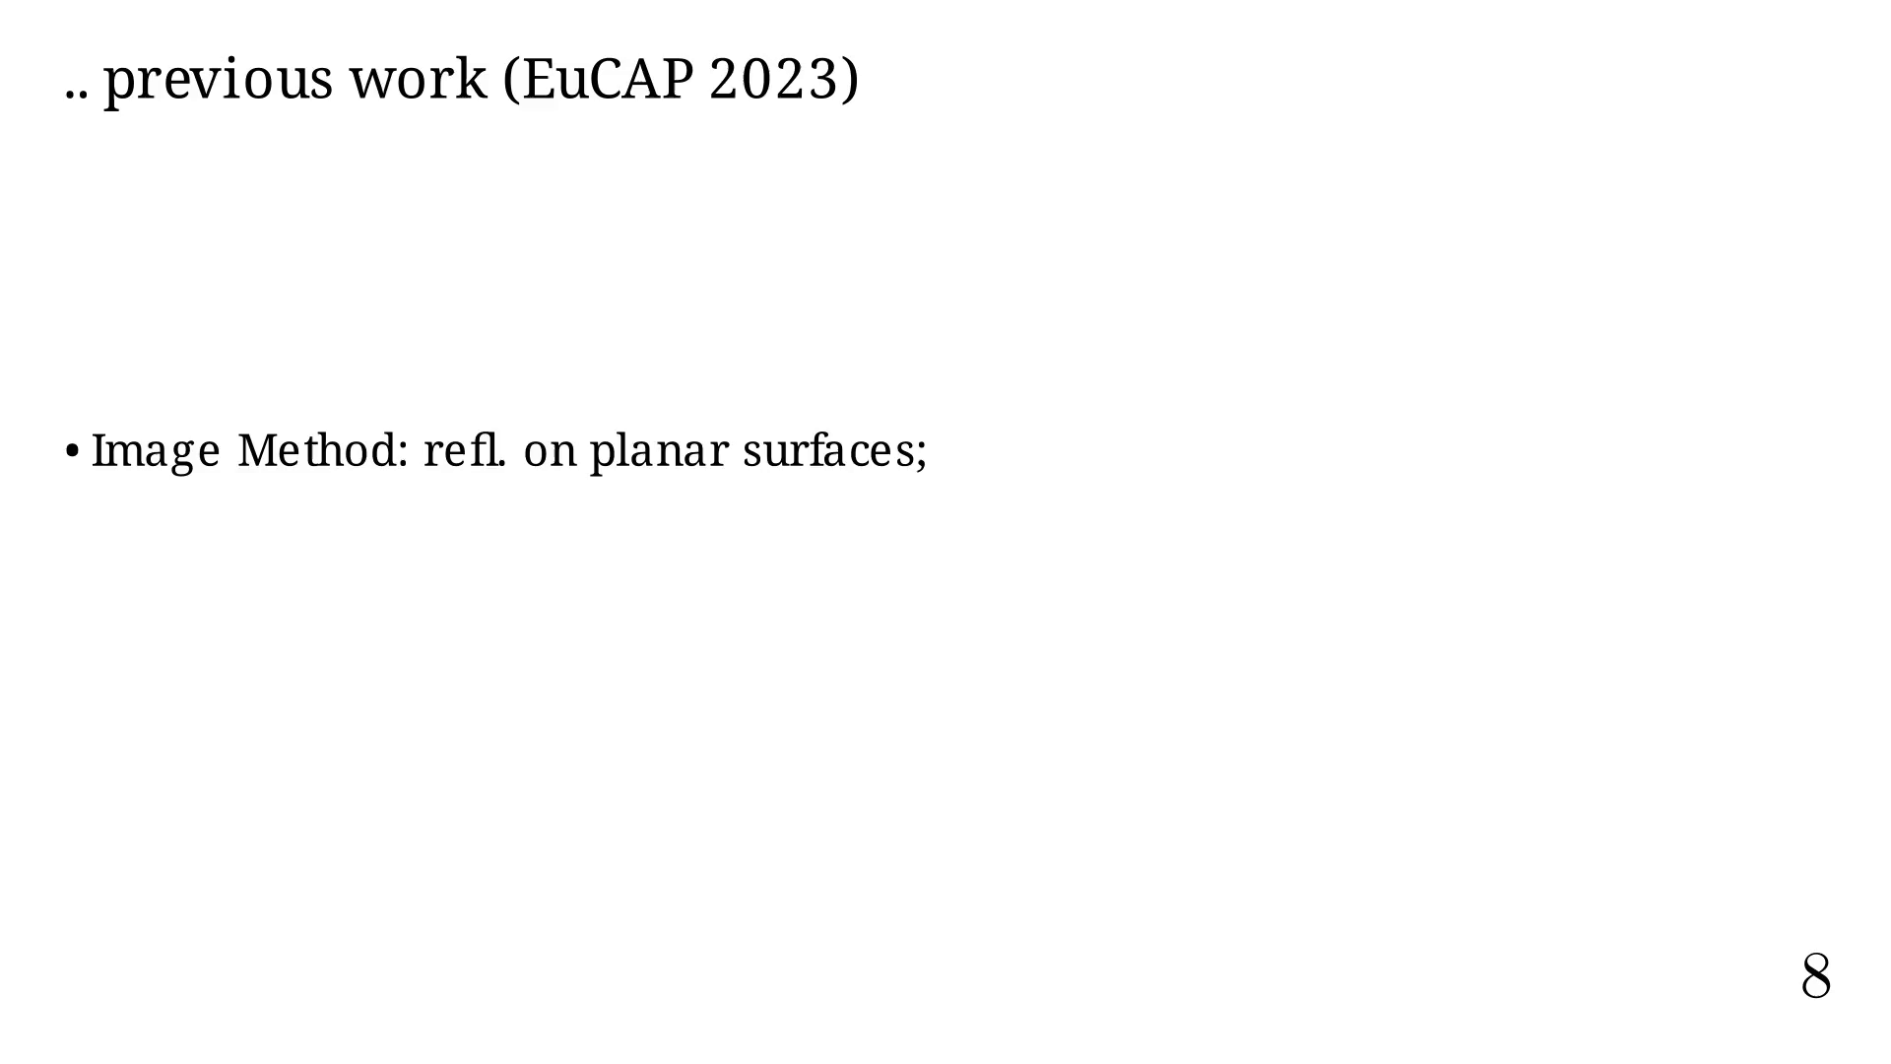
Notes:
FPT

Slide 32
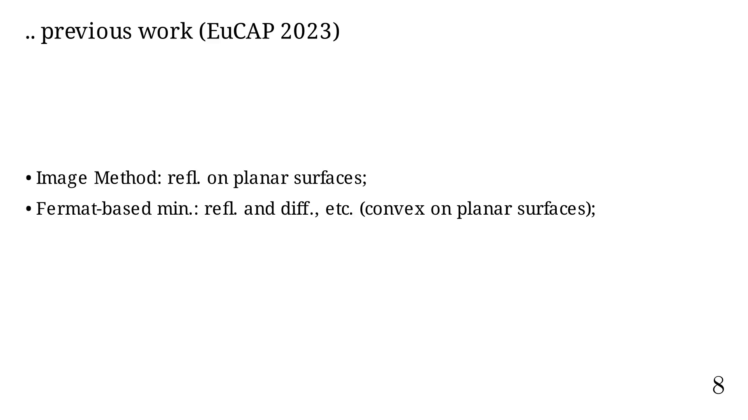
Notes:
MPT

Slide 33
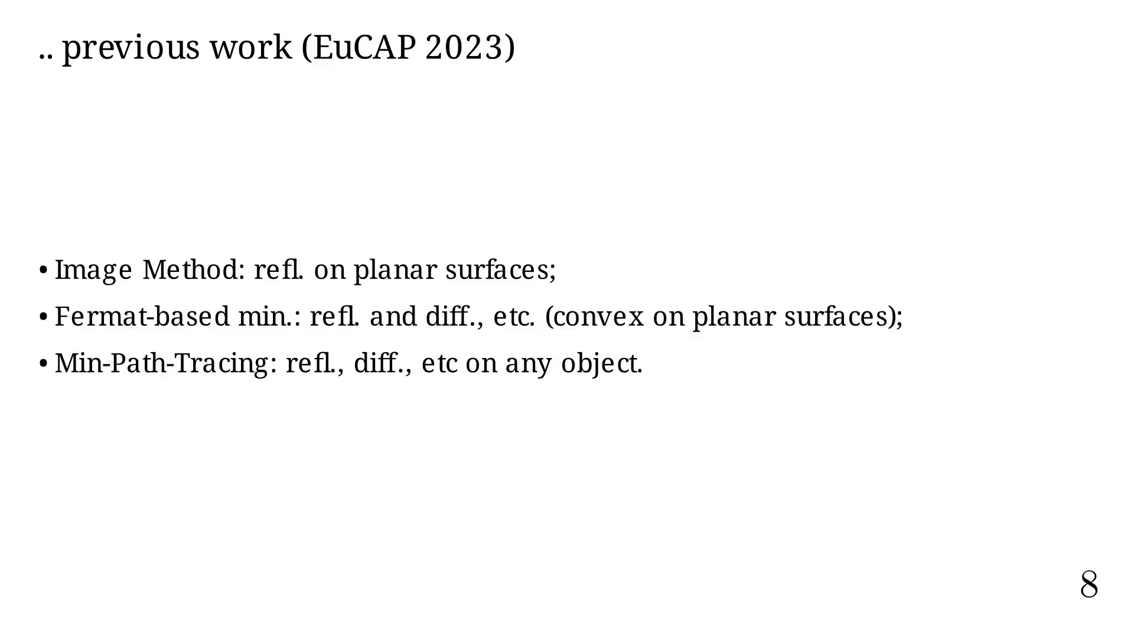
Notes:
See how MPT is applied in 3D.

Slide 34
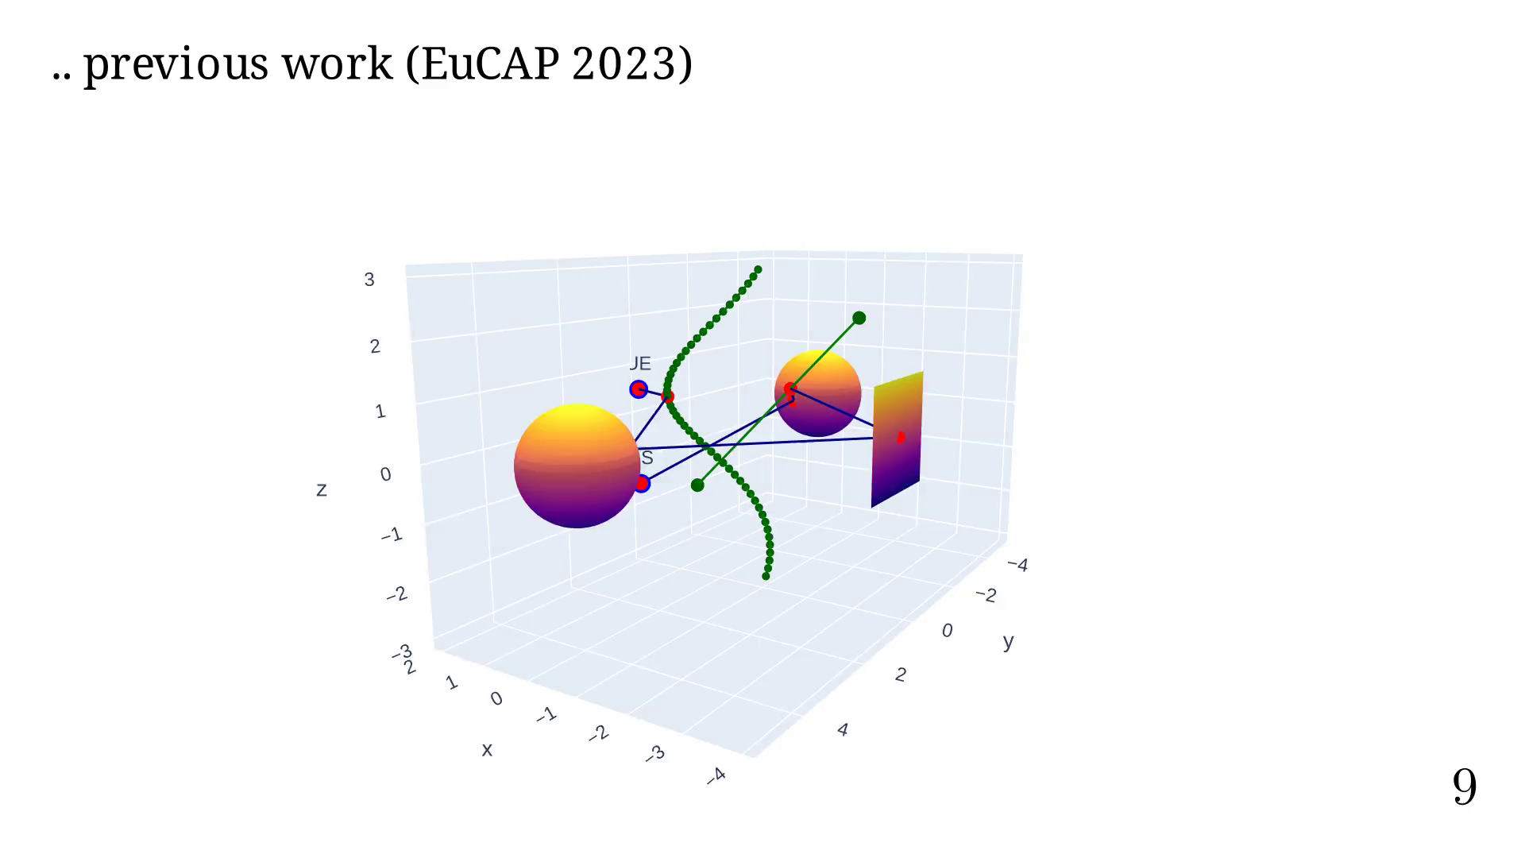

Slide 35
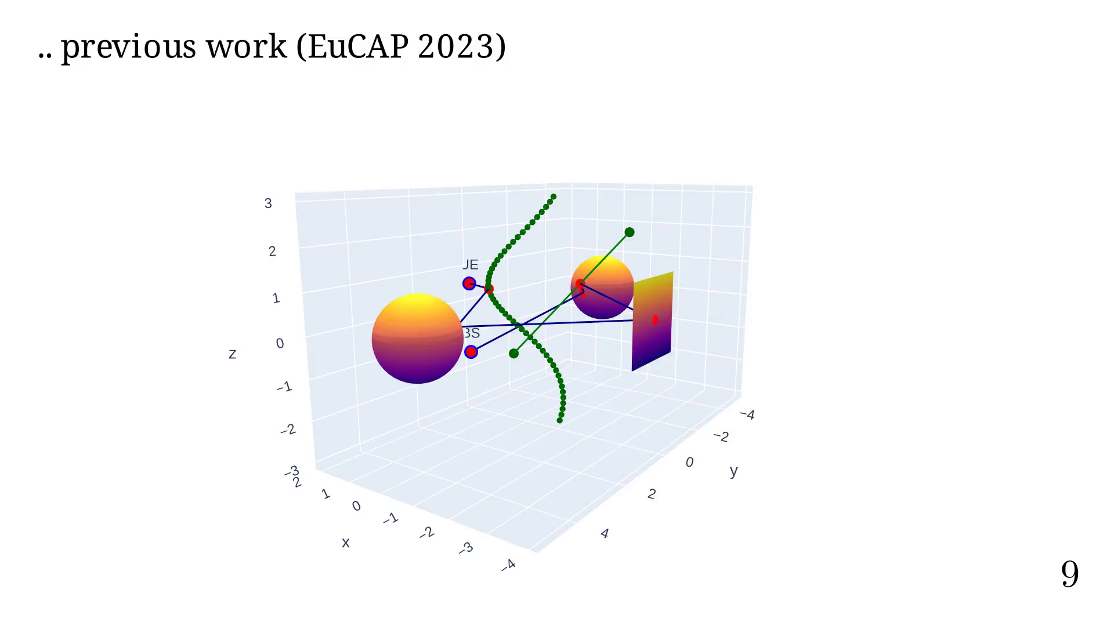
Notes:
# DRT

Slide 36
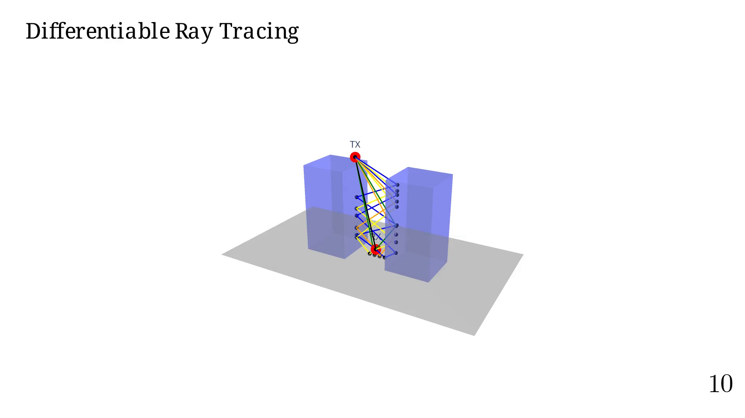
Notes:
We are often interested on computing the received
power as a function of the position.

Slide 37
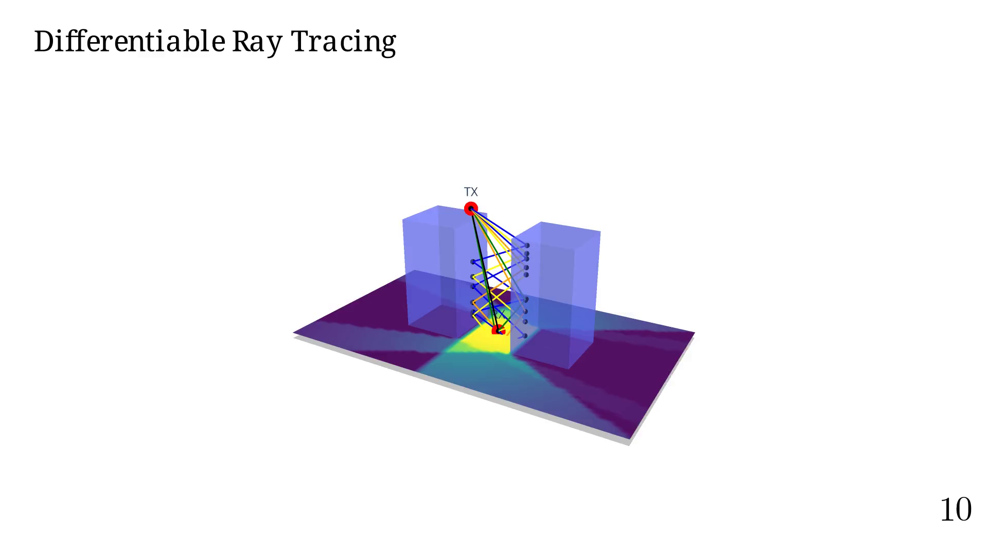
Notes:
Placing 'camera' on top X-Y view.
This gives us a very nice overview of what for call the
'coverage map'.

Slide 38
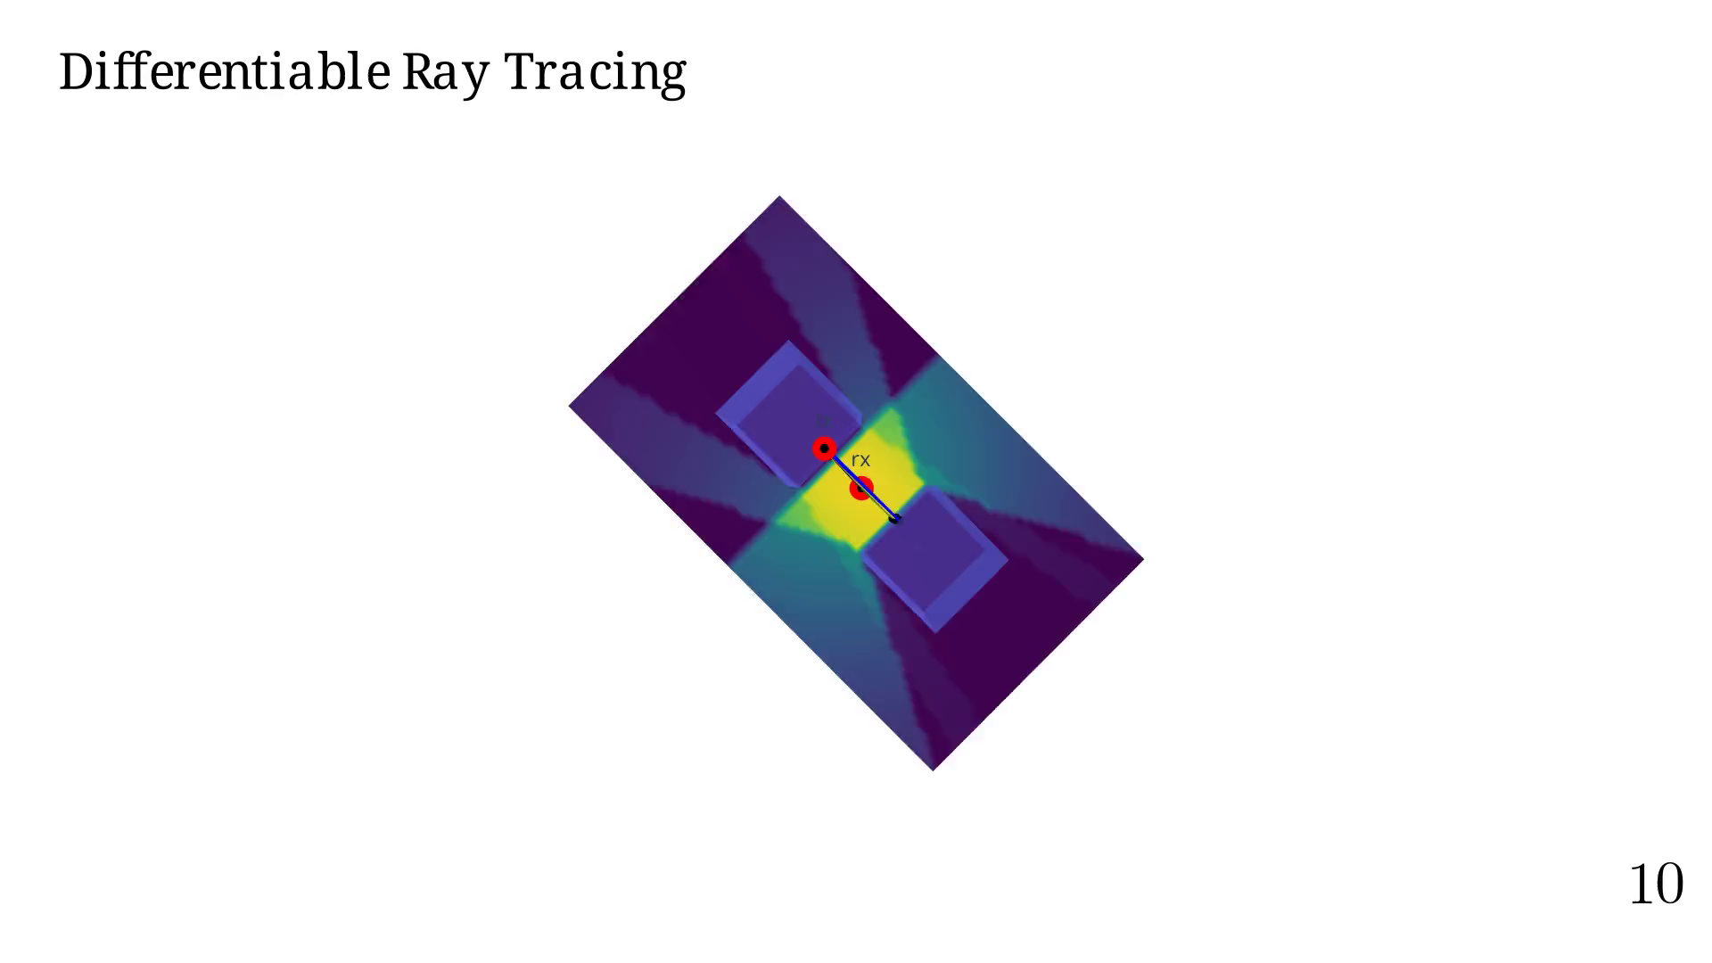
Notes:
Moving RX positiong to find the best position

Slide 39

Notes:
Moving TX positiong to find the best position

Slide 40
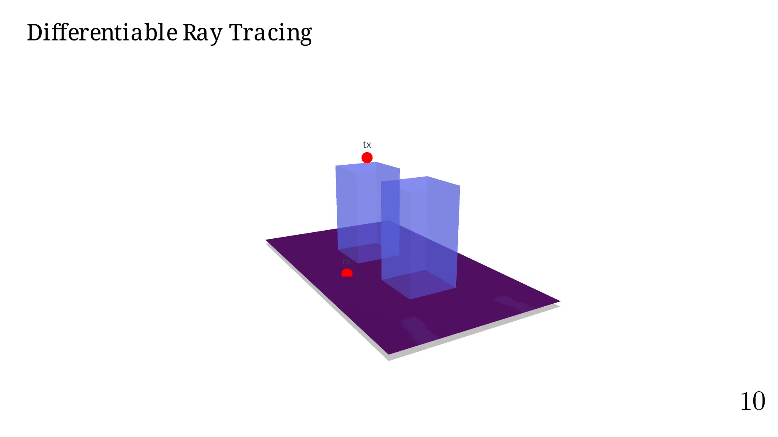
Notes:
Knowing the derivative would be useful...

Slide 41
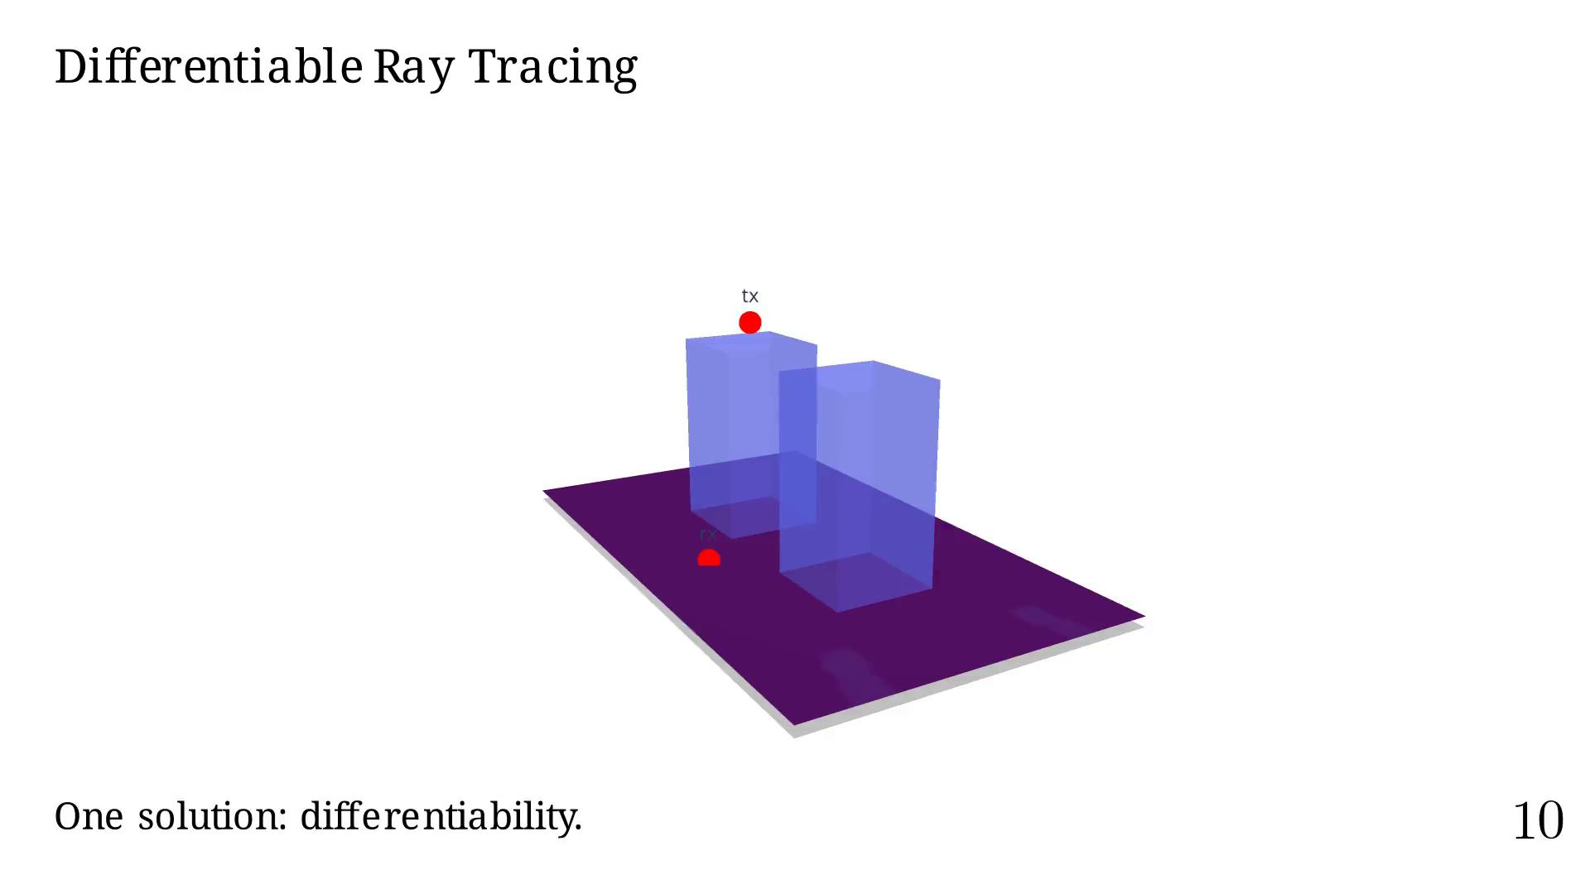
Notes:
Maybe one of the most recent and popular work on
DRT applied to radio-propagation is Sionna.

Slide 42
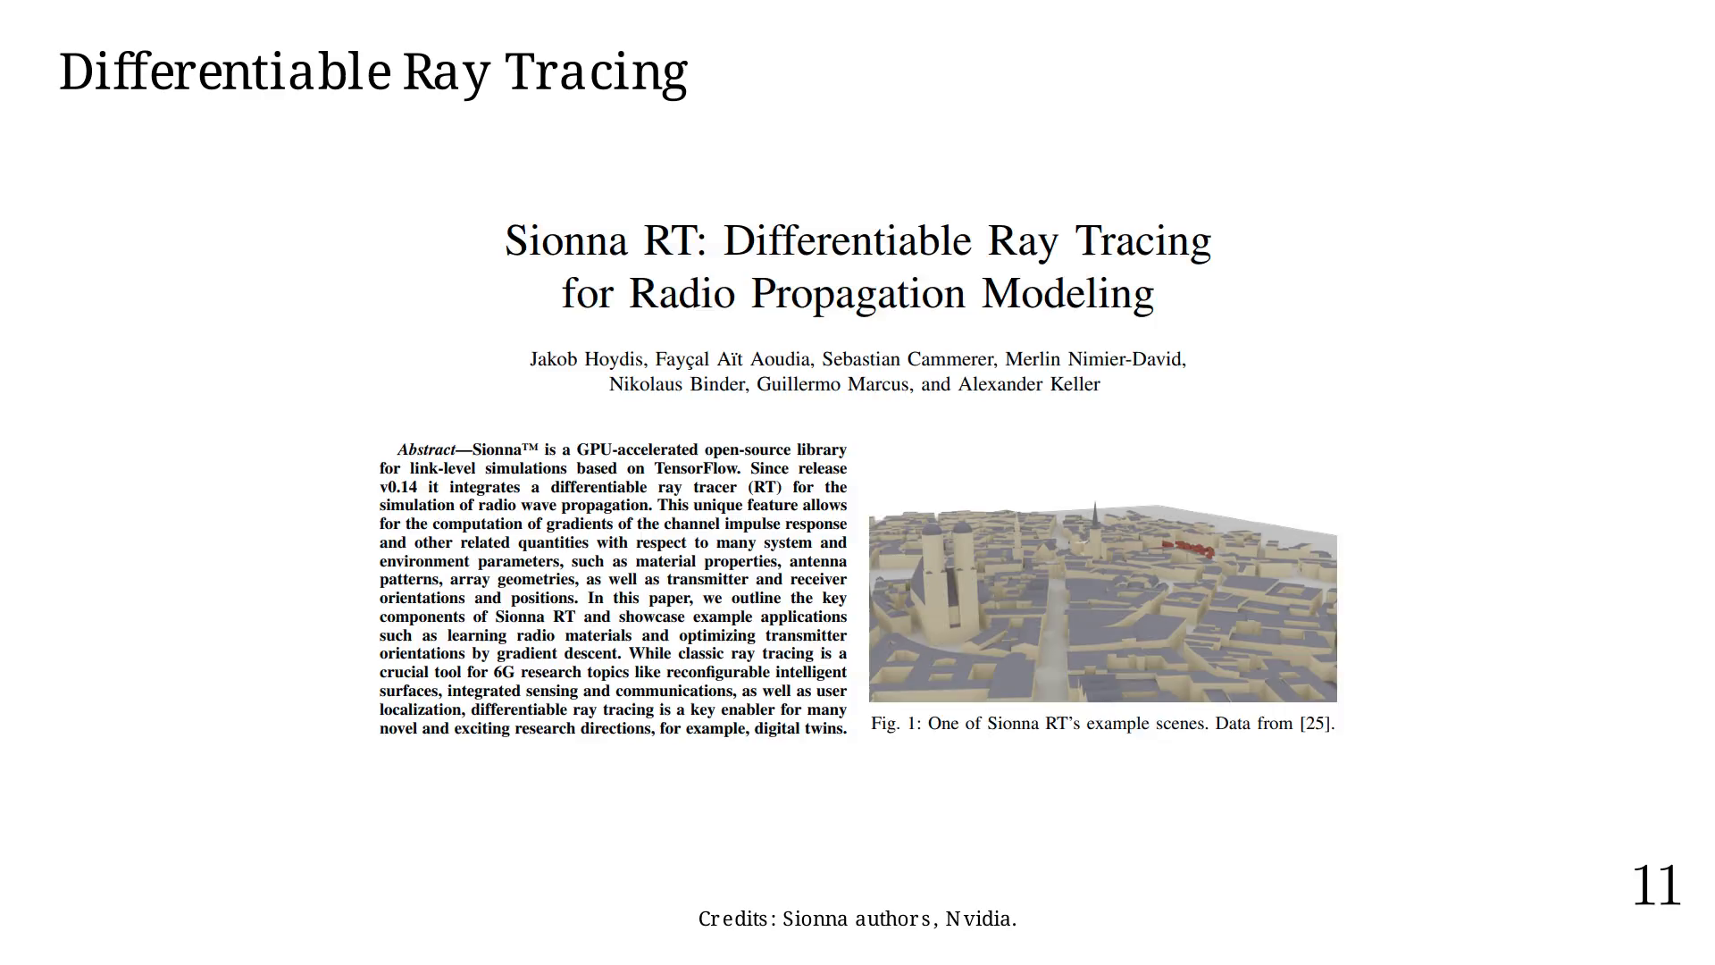
Notes:
Using auto-diff, they have created
an easy to use radio-network optimization tool.

Slide 43
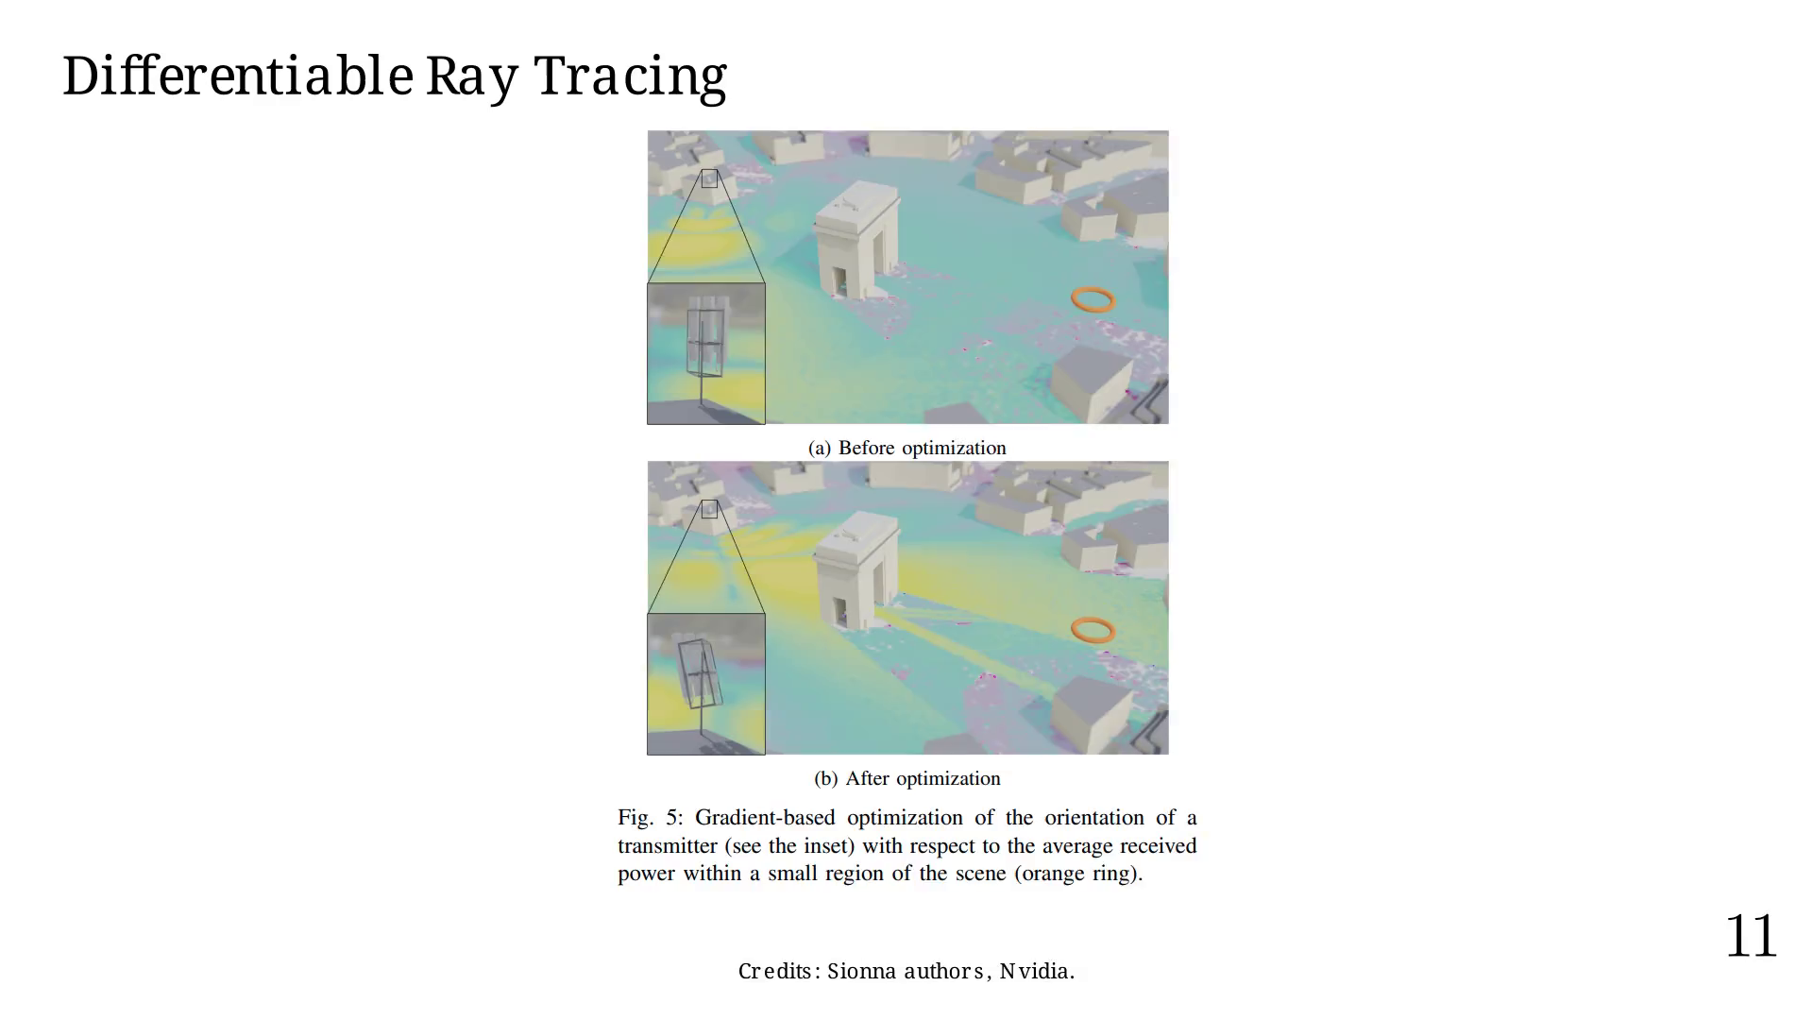
Notes:
RT's implementation presents many challenges,
mainly the exponential number of paths we can test.

Slide 44
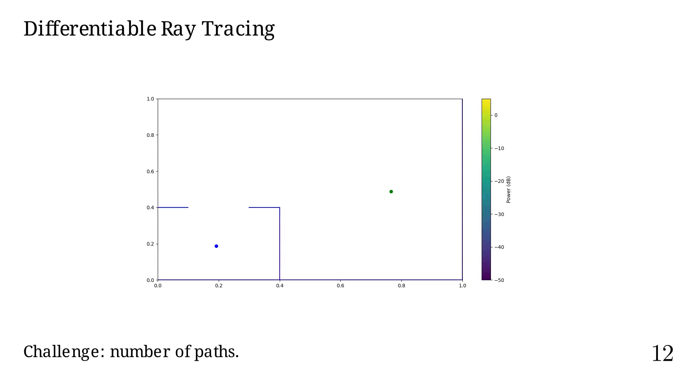
Notes:
Order = 0

Slide 45
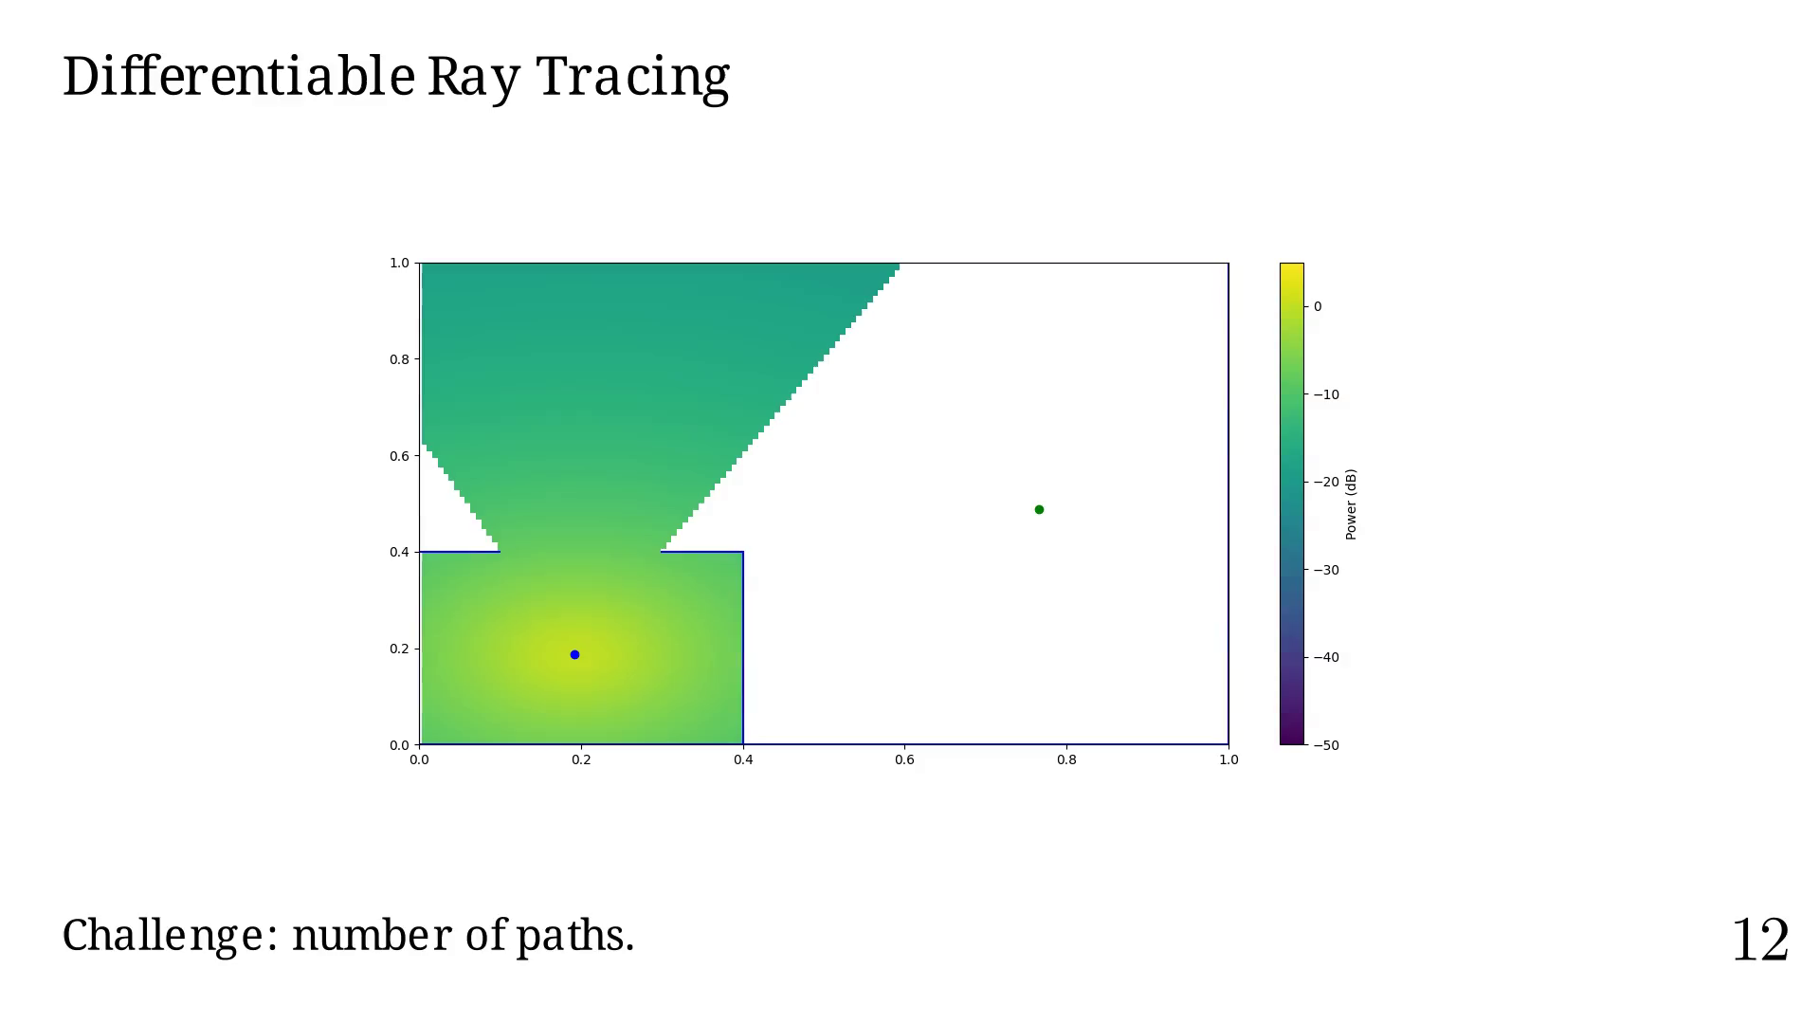
Notes:
Order = 1

Slide 46
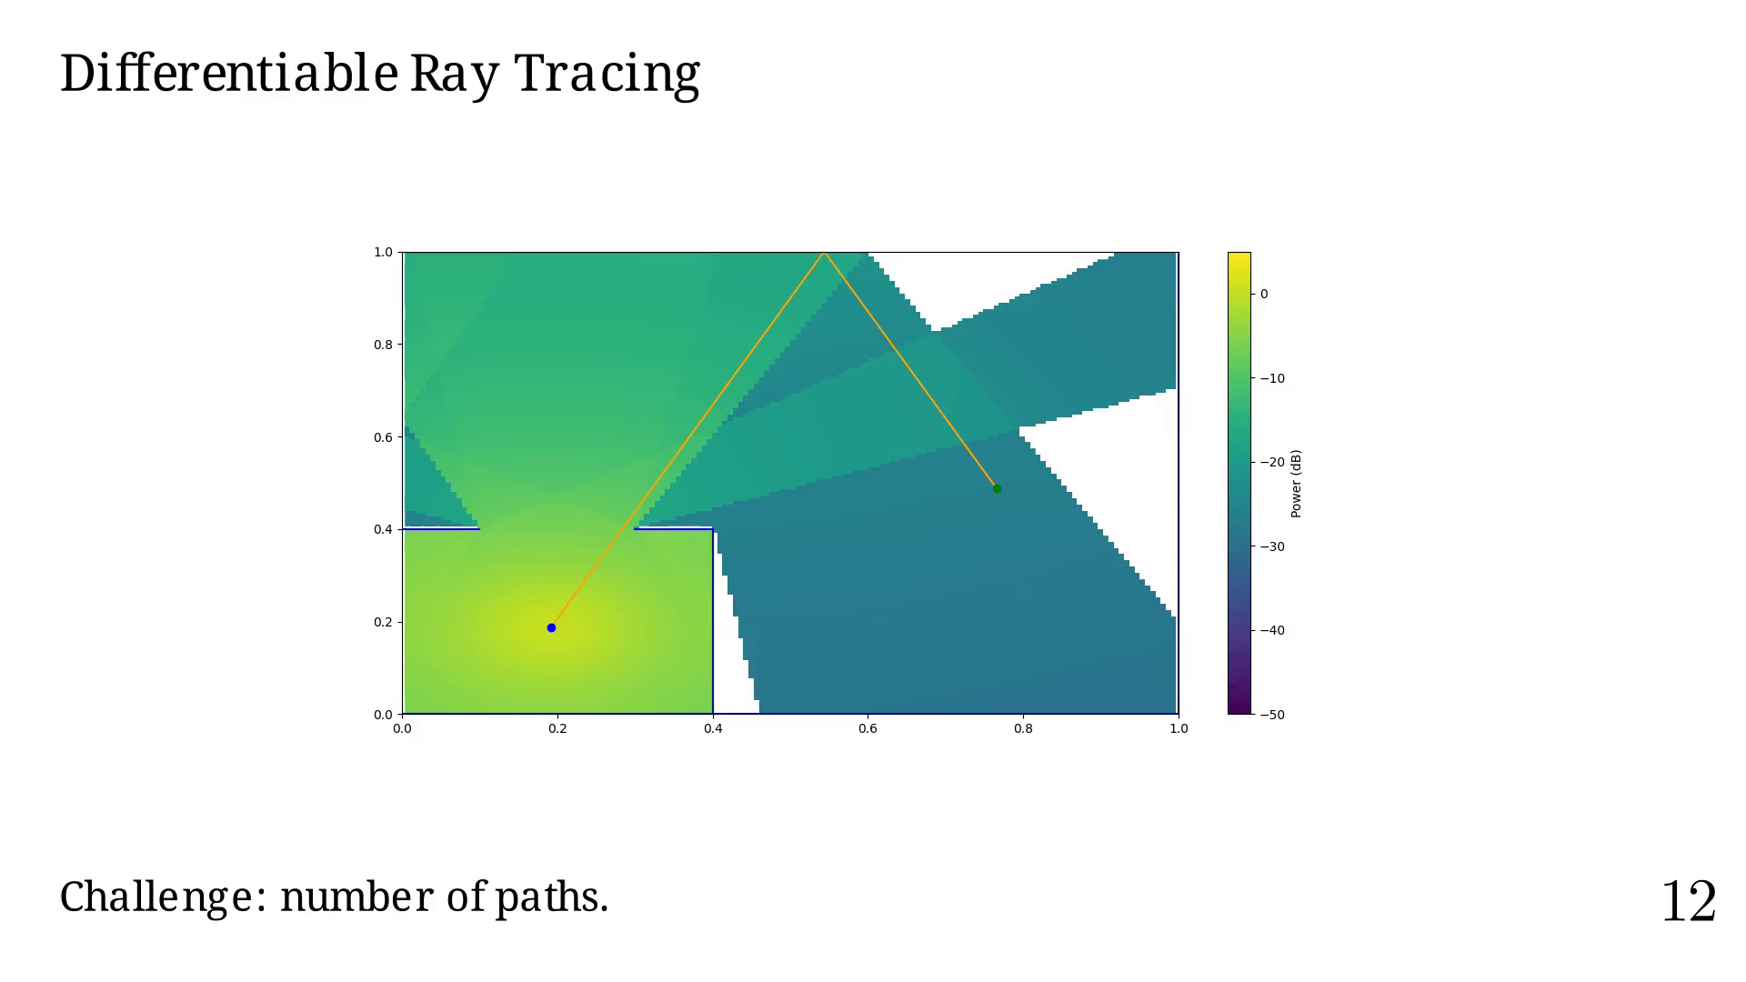
Notes:
Order = 2

Slide 47
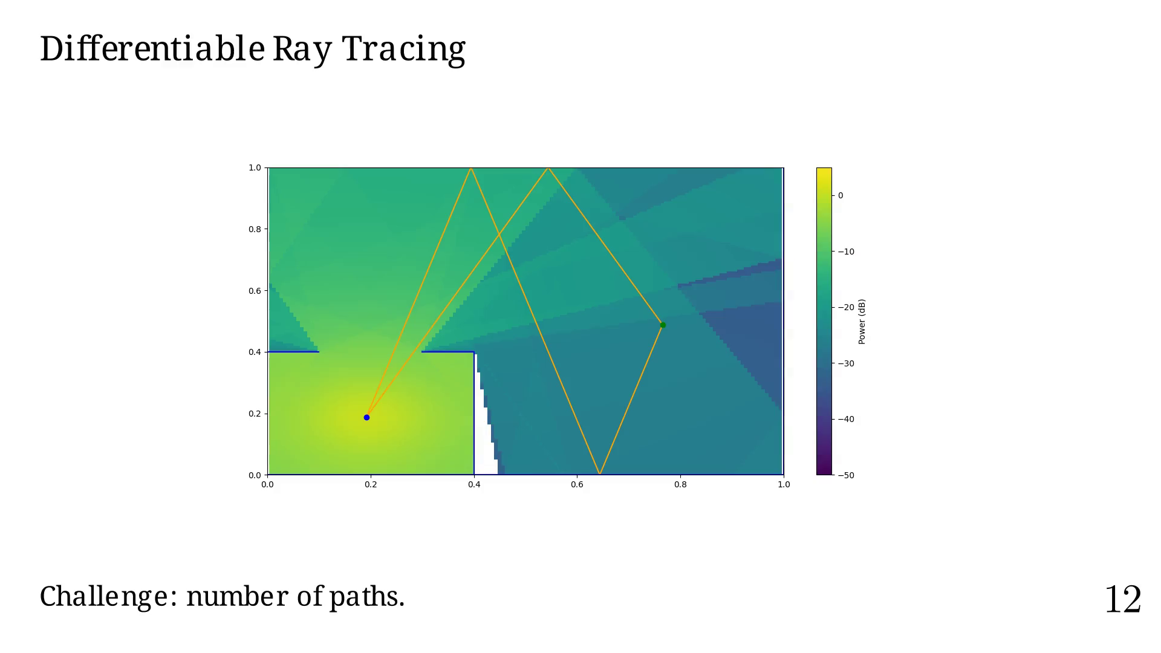
Notes:
Order = 3

Slide 48
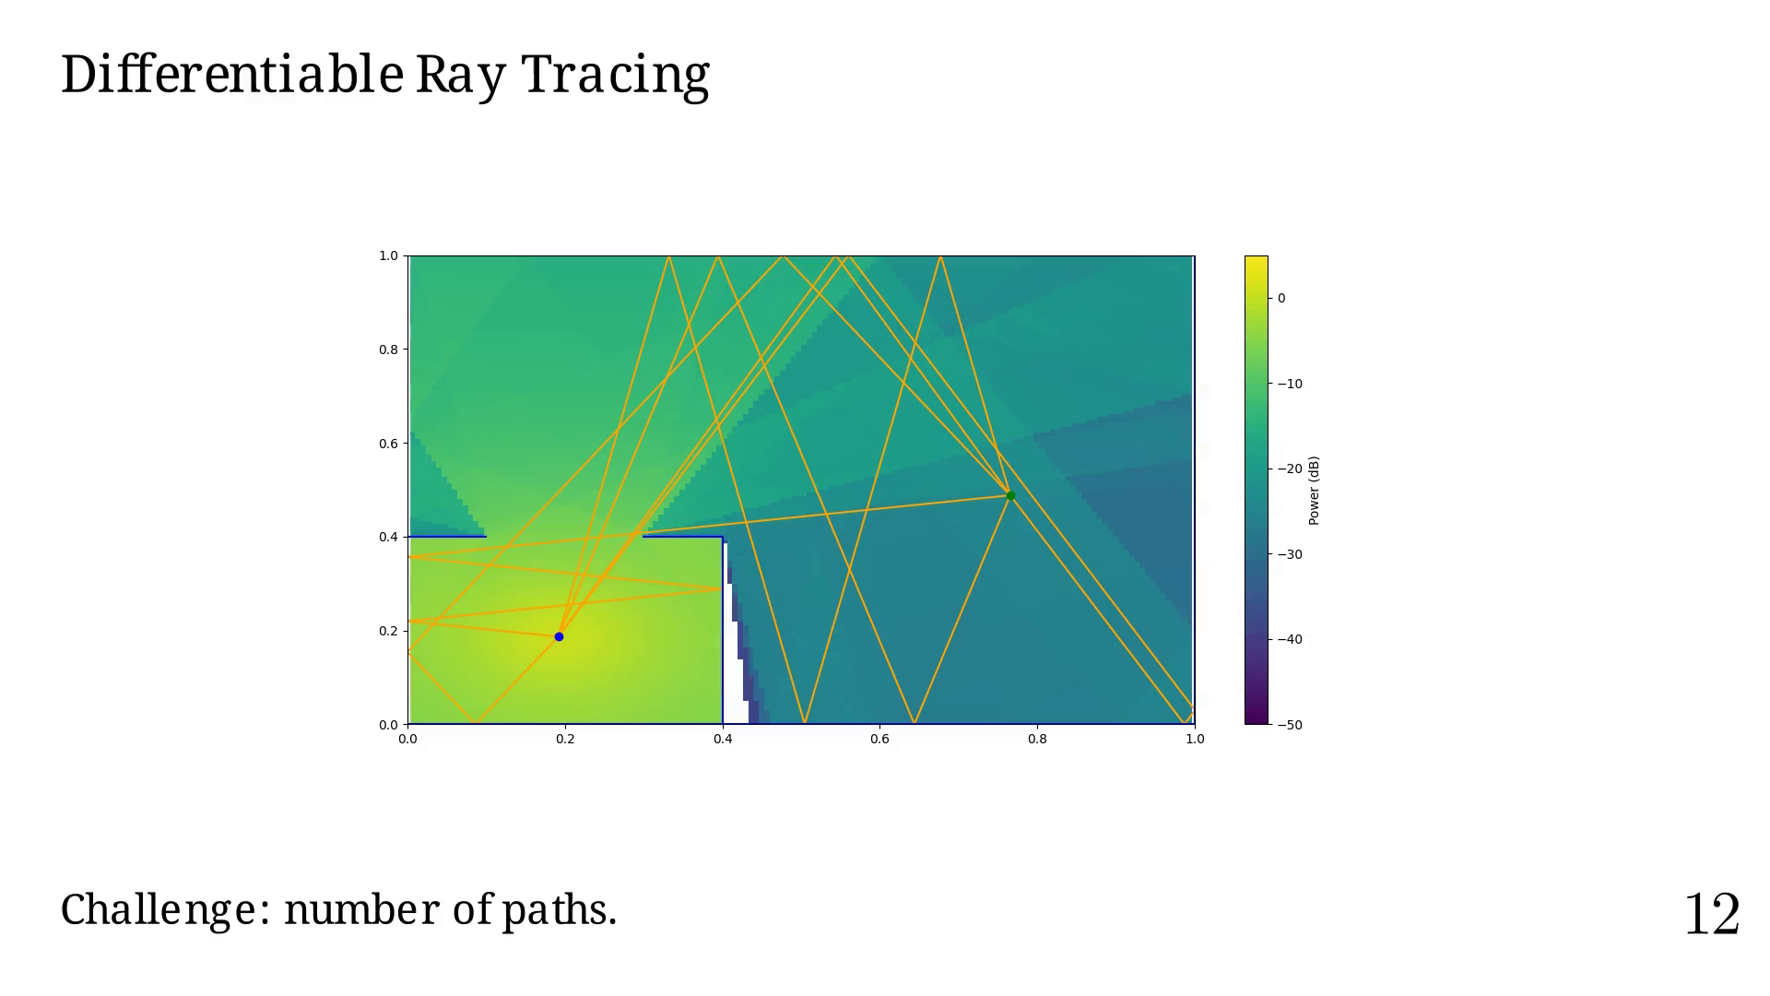
Notes:
Order = 4

Slide 49
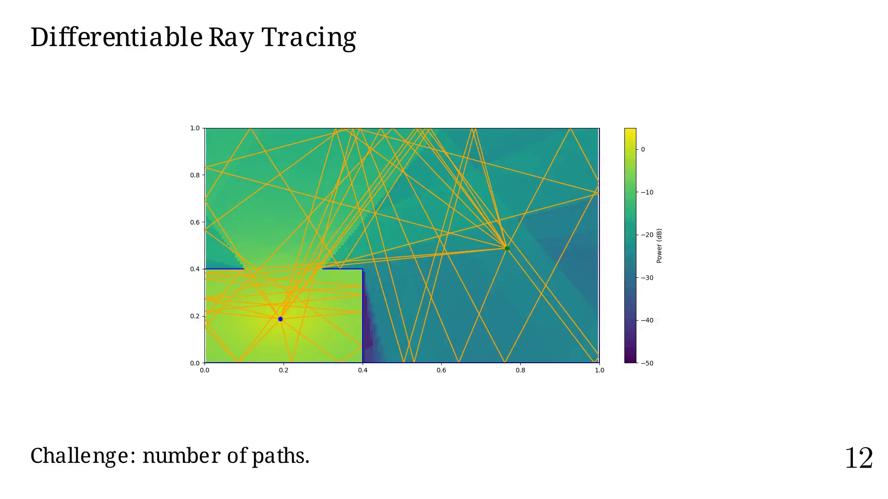
Notes:
Another challenge is the total path coverage versus
the order and types of interaction considered.

Slide 50
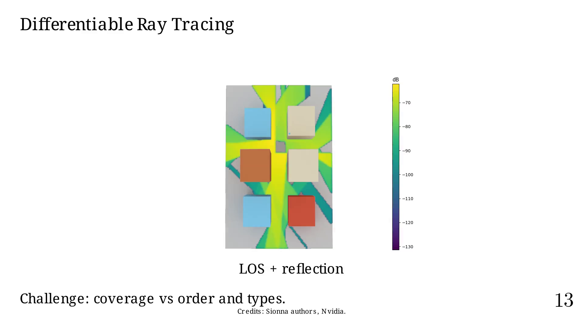
Notes:
If we add diffraction.

Slide 51
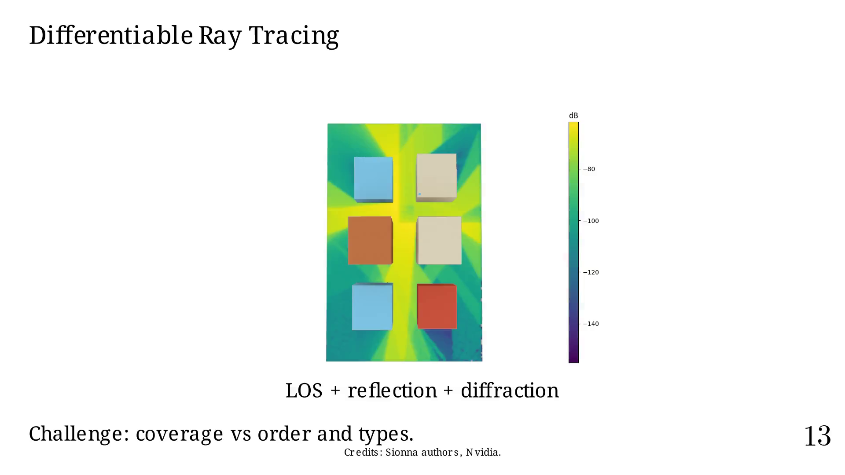
Notes:
Or if we add scattering.

Slide 52
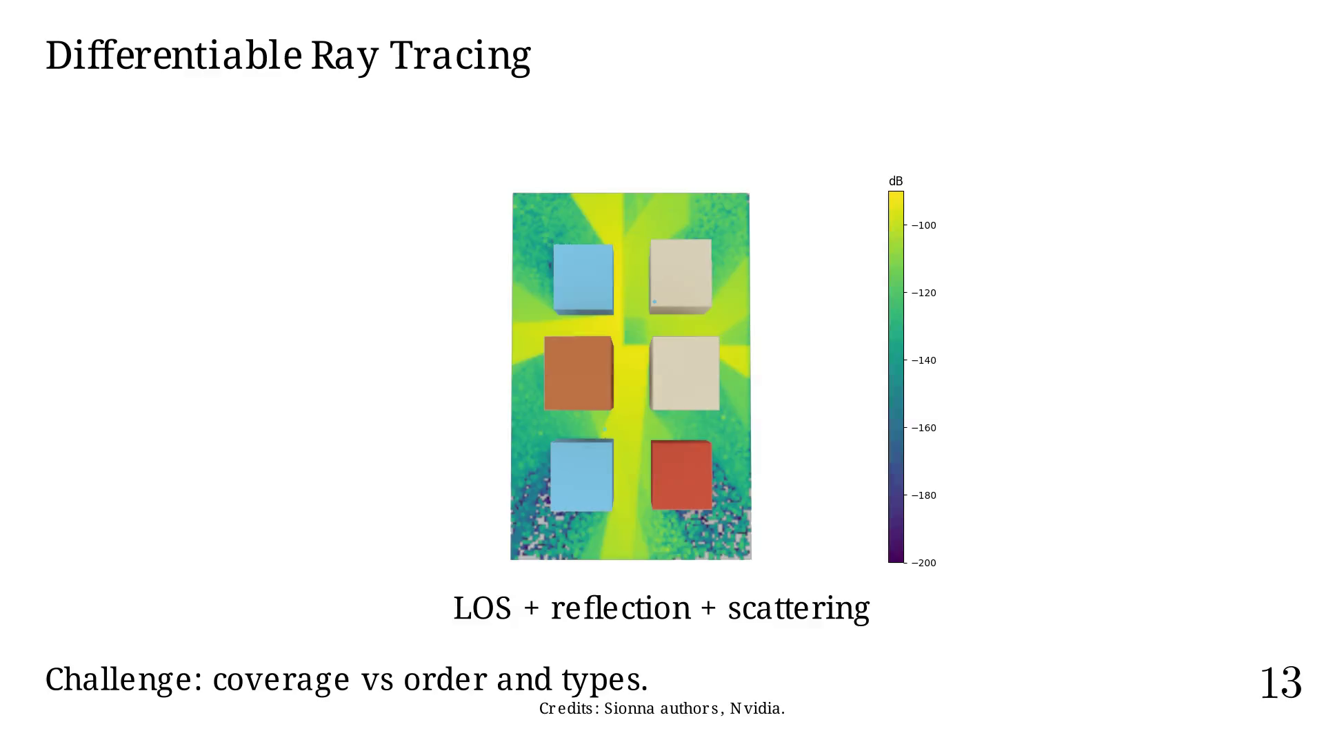
Notes:
Without those (possible infinitely) high-order
paths or complex interaction types, we have "holes"
in our domain, which is an issue for gradient-based
optimization.
What if we could have a fake transparancy that would
fake a possible link between RX and TX?

Slide 53
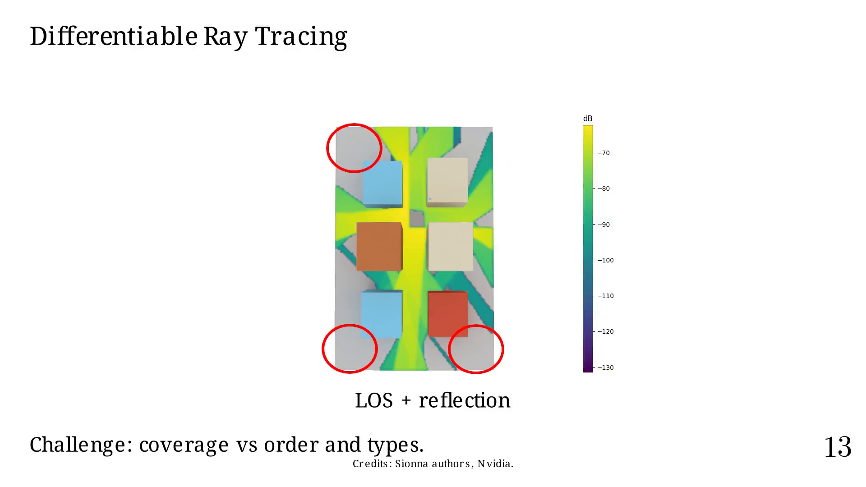
Notes:
Present work and contents

Slide 54
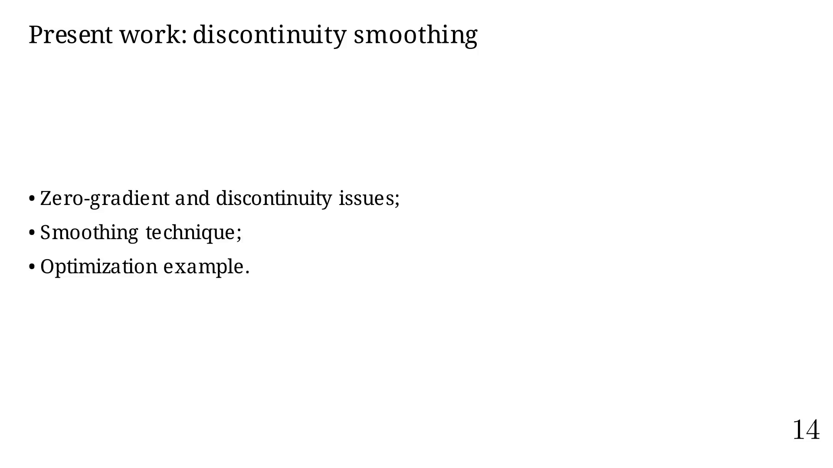
Notes:
Our problem is only piecewise diff. and continuous.

Slide 55
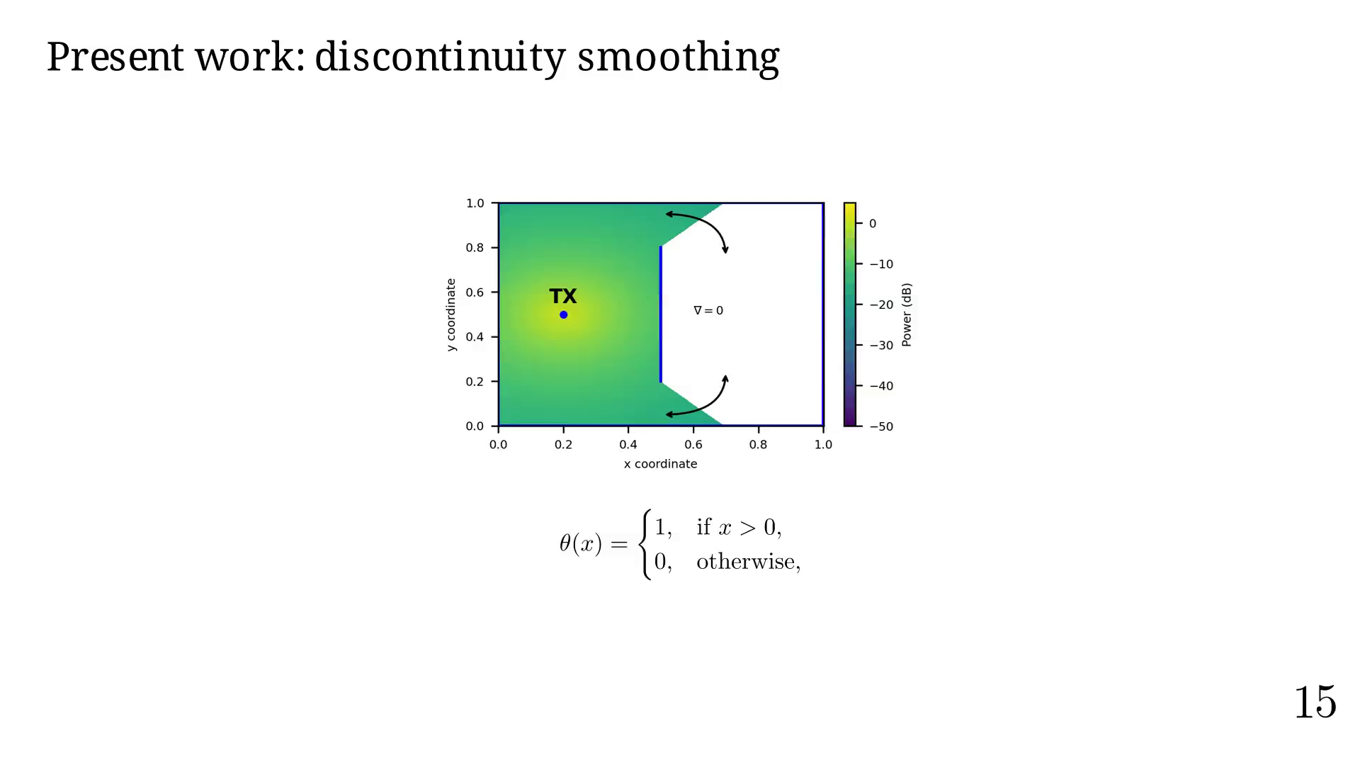
Notes:
Constraints about our approximation.

Slide 56
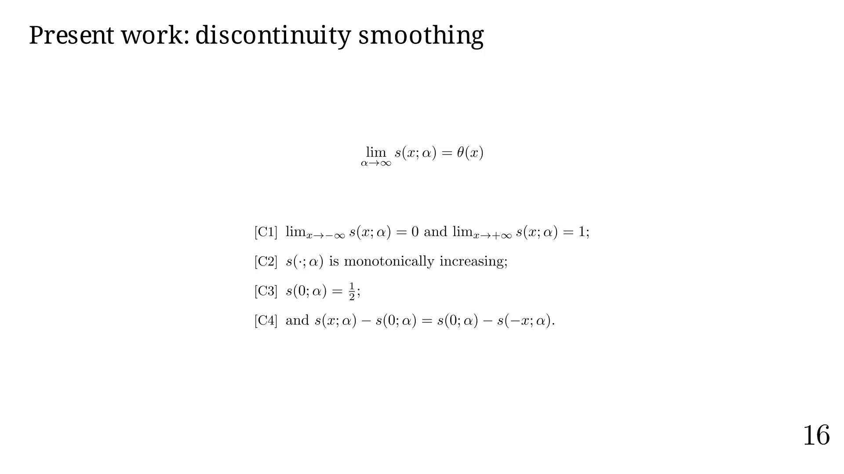
Notes:
Examples.

Slide 57
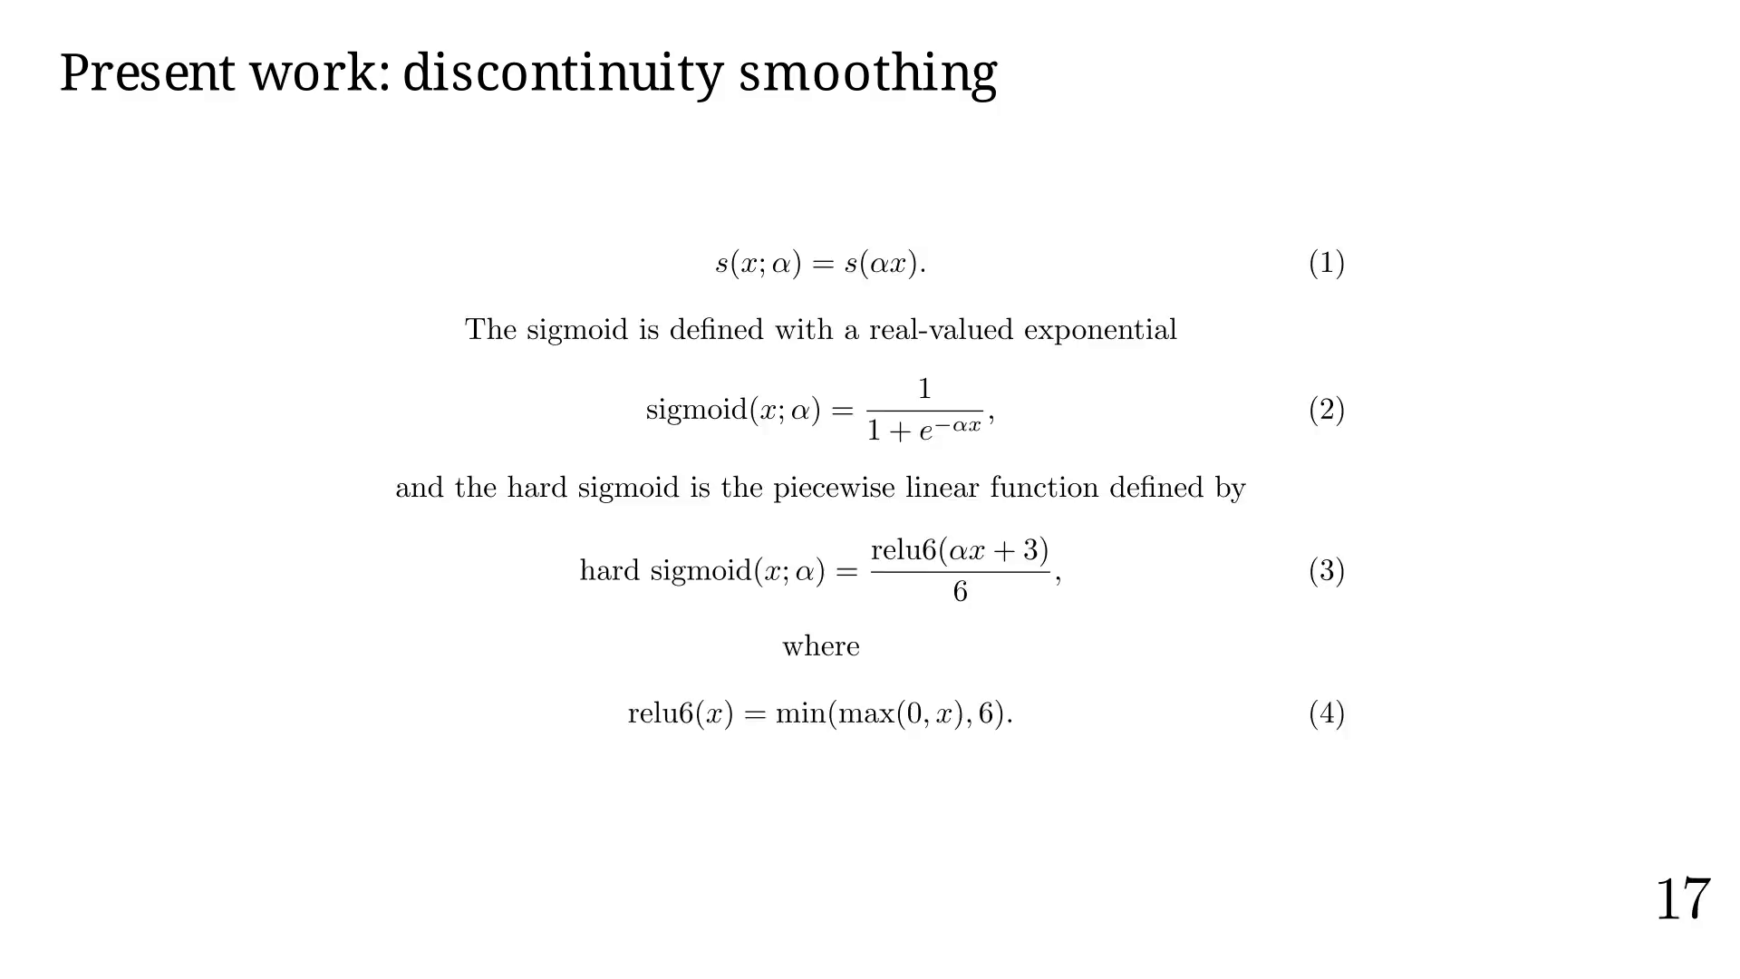

Slide 58
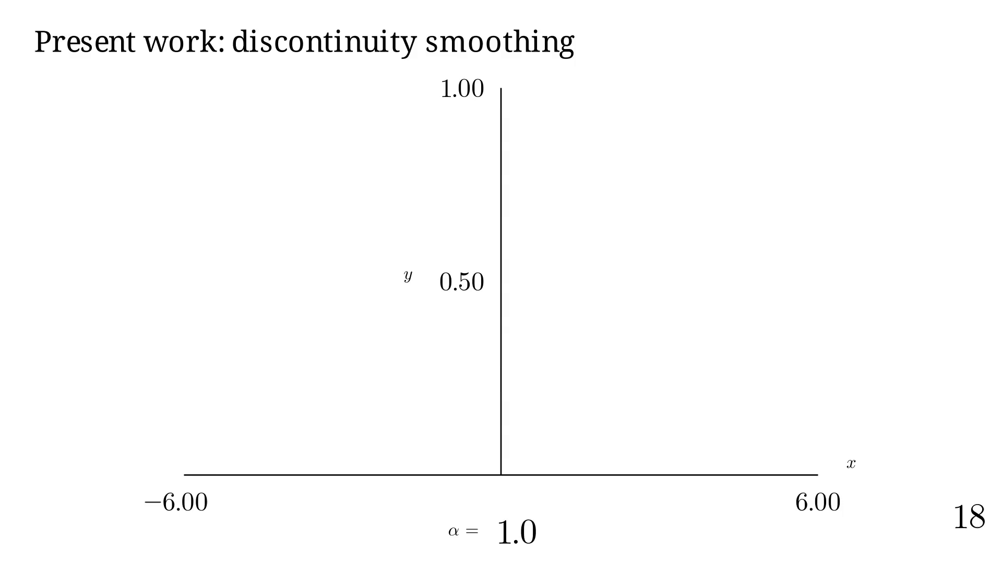

Slide 59
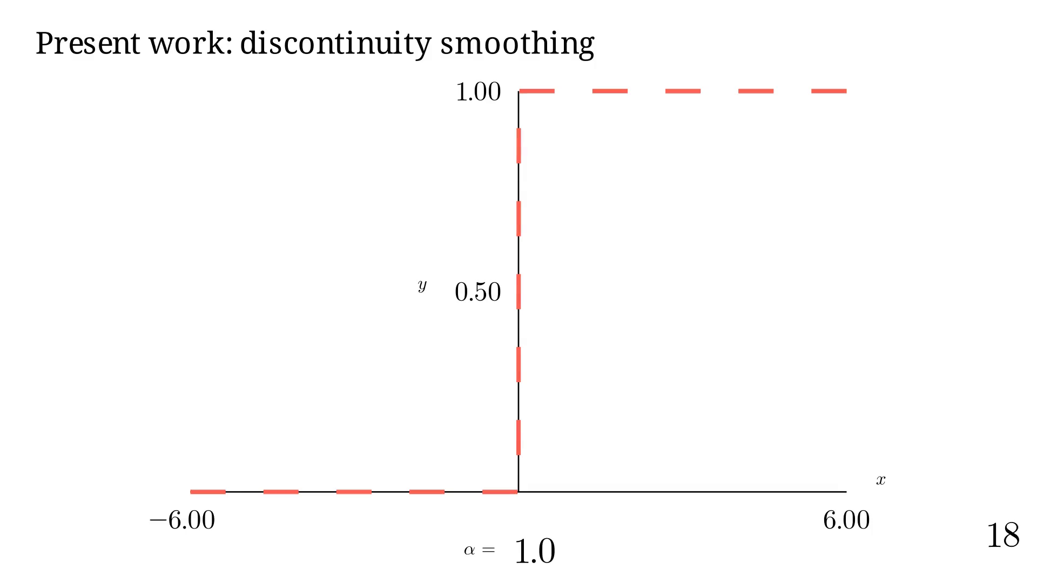

Slide 60


Slide 61

Notes:
Let's animate alpha.

Slide 62

Notes:
Thanks to that, and other things, we can create a fully DRT!

Slide 63

Notes:
We can create an optimization problem.

Slide 64

Notes:
Let's see how it converge.

Slide 65

Notes:
Showing steps

Slide 66

Notes:
Actually, tests have shown:
1.5 to 2 increase in success rate,
where 92% to 98% of already successful runs still converge
with our method.

Slide 67

Notes:
Future work

Slide 68

Notes:
Finals words

Slide 69

Notes:
That's all folks!

